Slide 1
The 14th Fundie
“The Millennial Reign of Christ”

Slide 2
The subject of the second coming of Christ includes the rapture of the saints, which is our blessed hope, followed by the visible return of Christ with His saints to reign on earth for 1,000 years Matt. 24: 27 & 30; Rev. 1:7, 19:11-14, 20:1-6).
Zech 14: 5, “…you will flee …then the Lord my God will come, and all the holy ones with Him.”

Slide 3
Matt. 24: 27 & 30
“For as lightning that comes from the east is visible even in the west, so will be the coming of the Son of Man…Then will appear the sign of the Son of Man in heaven. And then all the peoples of the earth will mourn when they see the Son of Man coming on the clouds of heaven, with power and great glory.”

Slide 4
Rev. 1:7, “Look, He is coming with the clouds,” and “every eye will see Him, even those who pierced Him”; and all peoples on earth “will mourn because of Him.” So shall it be! Amen.
19:11-14, “I (John) saw heaven standing open and there before me was a white horse, whose Rider is called Faithful and True. With justice He judges and wages war. His eyes are like blazing fire, and on His head are many crowns. He has a name written on Him that no one knows but He Himself. He is dressed in a robe dipped in blood, and His name is the Word of God. The armies of heaven were following Him, riding on white horses and dressed in fine linen, white and clean.”

Slide 5
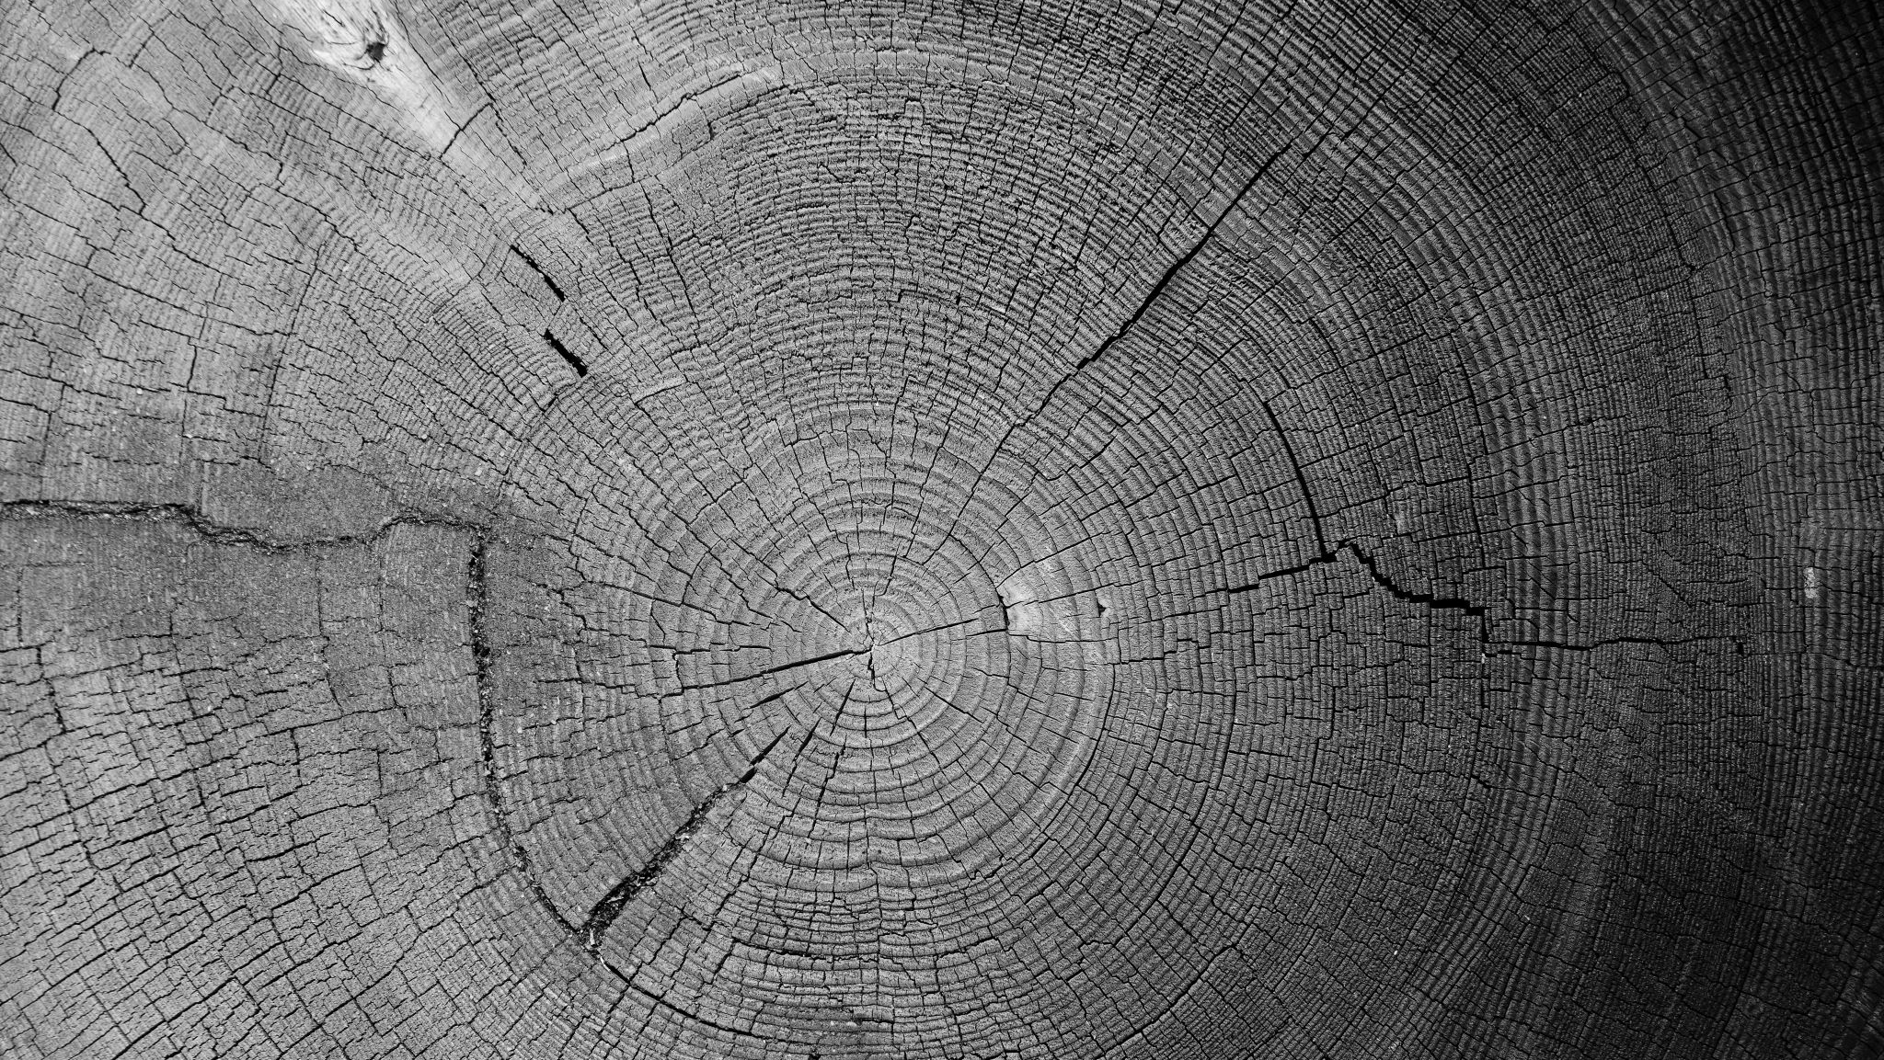
Rev. 20: 1-6, “I saw an angel coming down out of heaven, having the key to the Abyss and holding in his hand a great chain. He seized the dragon, the ancient serpent, who is the devil, or Satan, and bound him for 1,000 years. He threw him into the Abyss, and locked and sealed it over him, to keep him from deceiving the nations anymore until 1,000 years were ended. After that, he must be set free for a short time. I saw the thrones on which were seated those who had been given authority to judge. And I saw the souls of those who had been beheaded because of their testimony about Jesus and because of the word of God. They had not worshiped the beast or its image and had not received the mark on their foreheads or their hands. They came to life and reigned with Christ a 1,000 years. (The rest of the dead did not come to life until the 1,000 years were ended.) This was the first resurrection. Blessed and holy are those who share in the first resurrection. The second death has no power over them, but they will be priests of God and of Christ and will reign with Him for a 1,000 years.

Slide 6
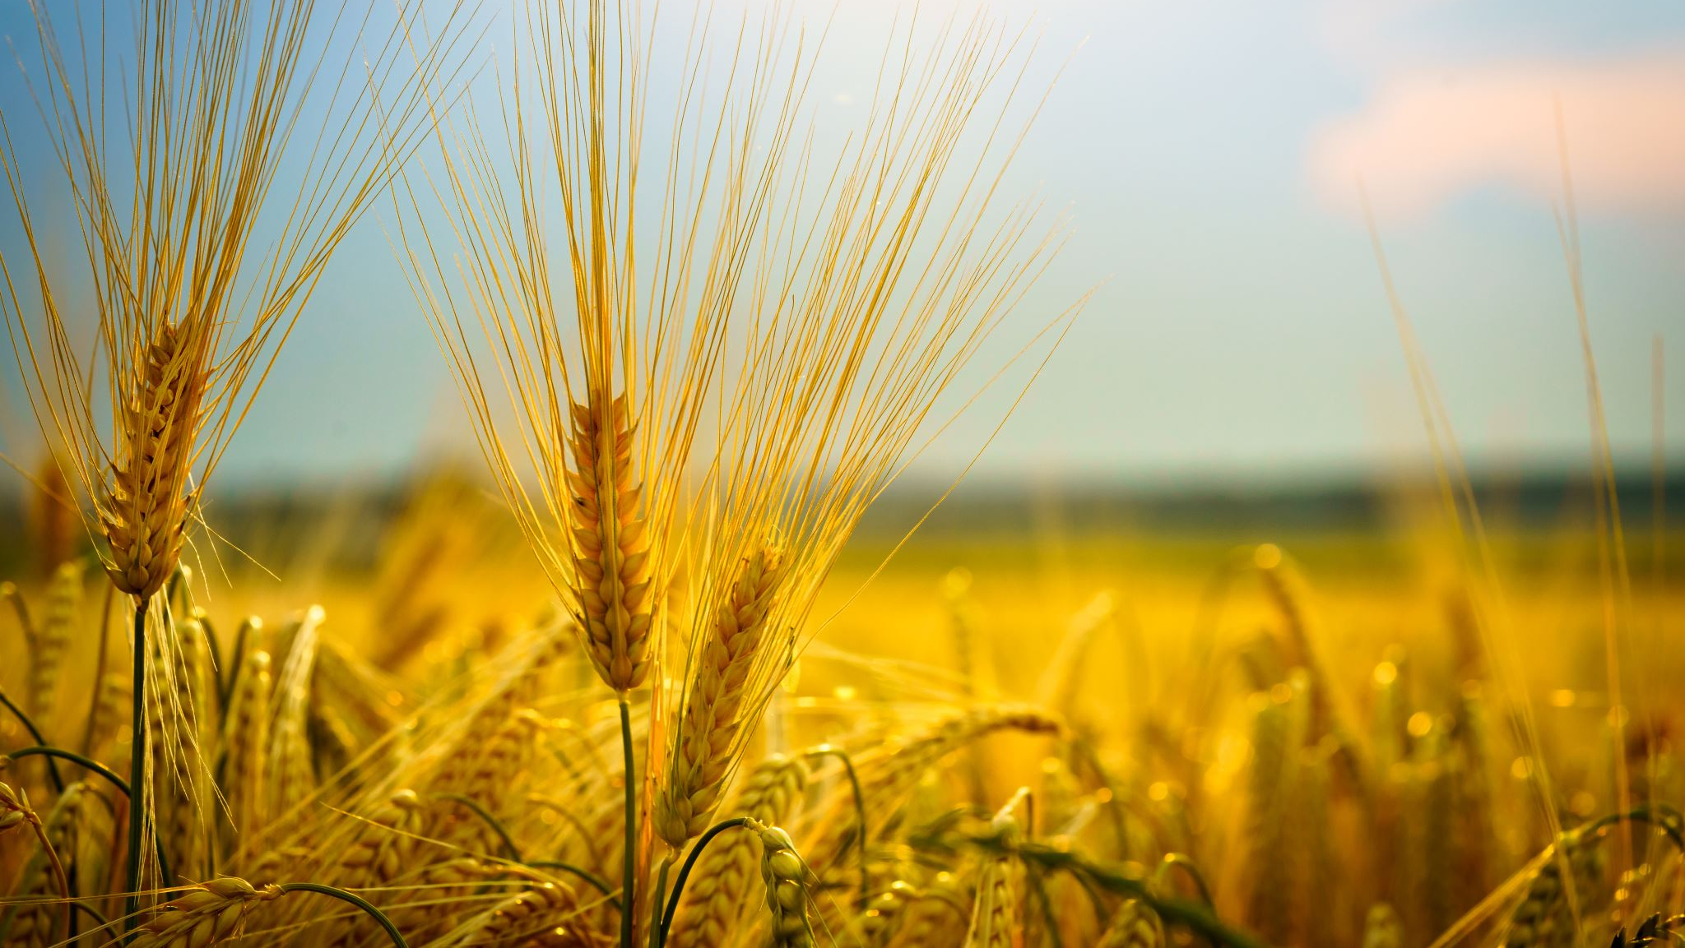
The millennial reign will bring the salvation of the nation of Israel:
Ezek. 37:21-22 “…This is what the Sovereign Lord says: I will take the Israelites out of the nations where they have gone. I will gather them from all around and bring them back to their own land. I will make them one nation in the land, on the mountains of Israel. There will be one King over all of them and they will never again be two nations or be divided into two kingdoms.”

Slide 7
Zeph. 3:19-20, “At that time I will deal with all who oppressed you. I will rescue the lame; I will gather the exiles. I will give them praise and honor in every land where they have suffered shame. At that time I will gather you; at that time I will bring you home. I will give you honor and praise among all the peoples of the earth….”
Rom. 11: 26-27, “…and in this way all Israel will be saved. As it is written: The deliverer will come from Zion; He will turn godlessness away from Jacob. And this is My covenant with them when I take away their sins.”

Slide 8
Establishment of universal peace:
Ps. 72:3-8, “May the mountains bring prosperity to the people, the hills the fruit of righteousness. May He defend the afflicted among the people and save the children of the needy; may He crush the oppressor. May He endure as long as the sun, as long as the moon, through all generations. May he be like rain falling on a mown field, like showers watering the earth. In His days may the righteous flourish and prosperity abound till the moon is no more. May He rule from sea to sea and from the River (Euphrates) to the ends of the earth.”

Slide 9
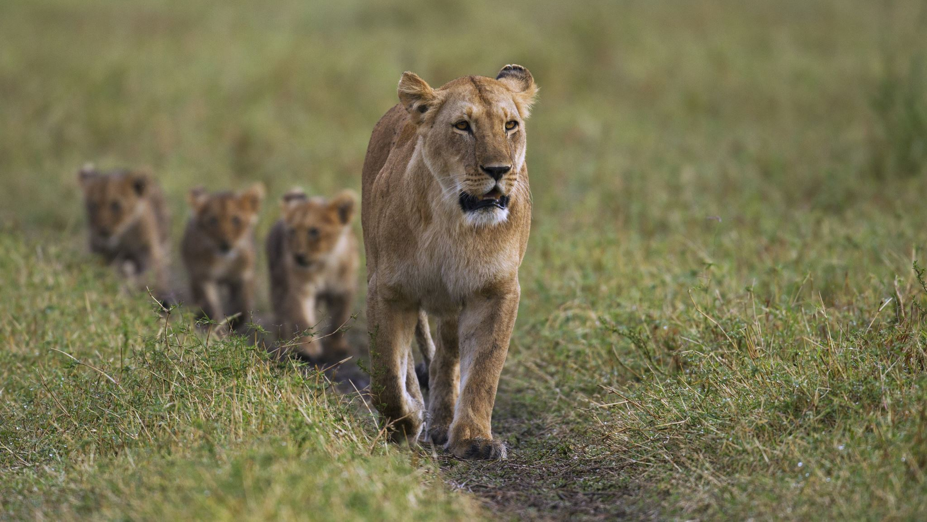
Is. 11: 6-9, “And the wolf will live with the lamb, the leopard will lie down with the goat, the calf and the lion and the yearling together; and a little child shall lead them. The cow will feed with the bear, their young will lie down together, and the lion will eat straw like the ox. The infant will play near the cobra’s den, and the young child will put its hand into the viper’s nest. They will neither harm nor destroy on all my holy mountain, for the earth will be filled with the knowledge of the Lord as the waters cover the sea.”

Slide 10
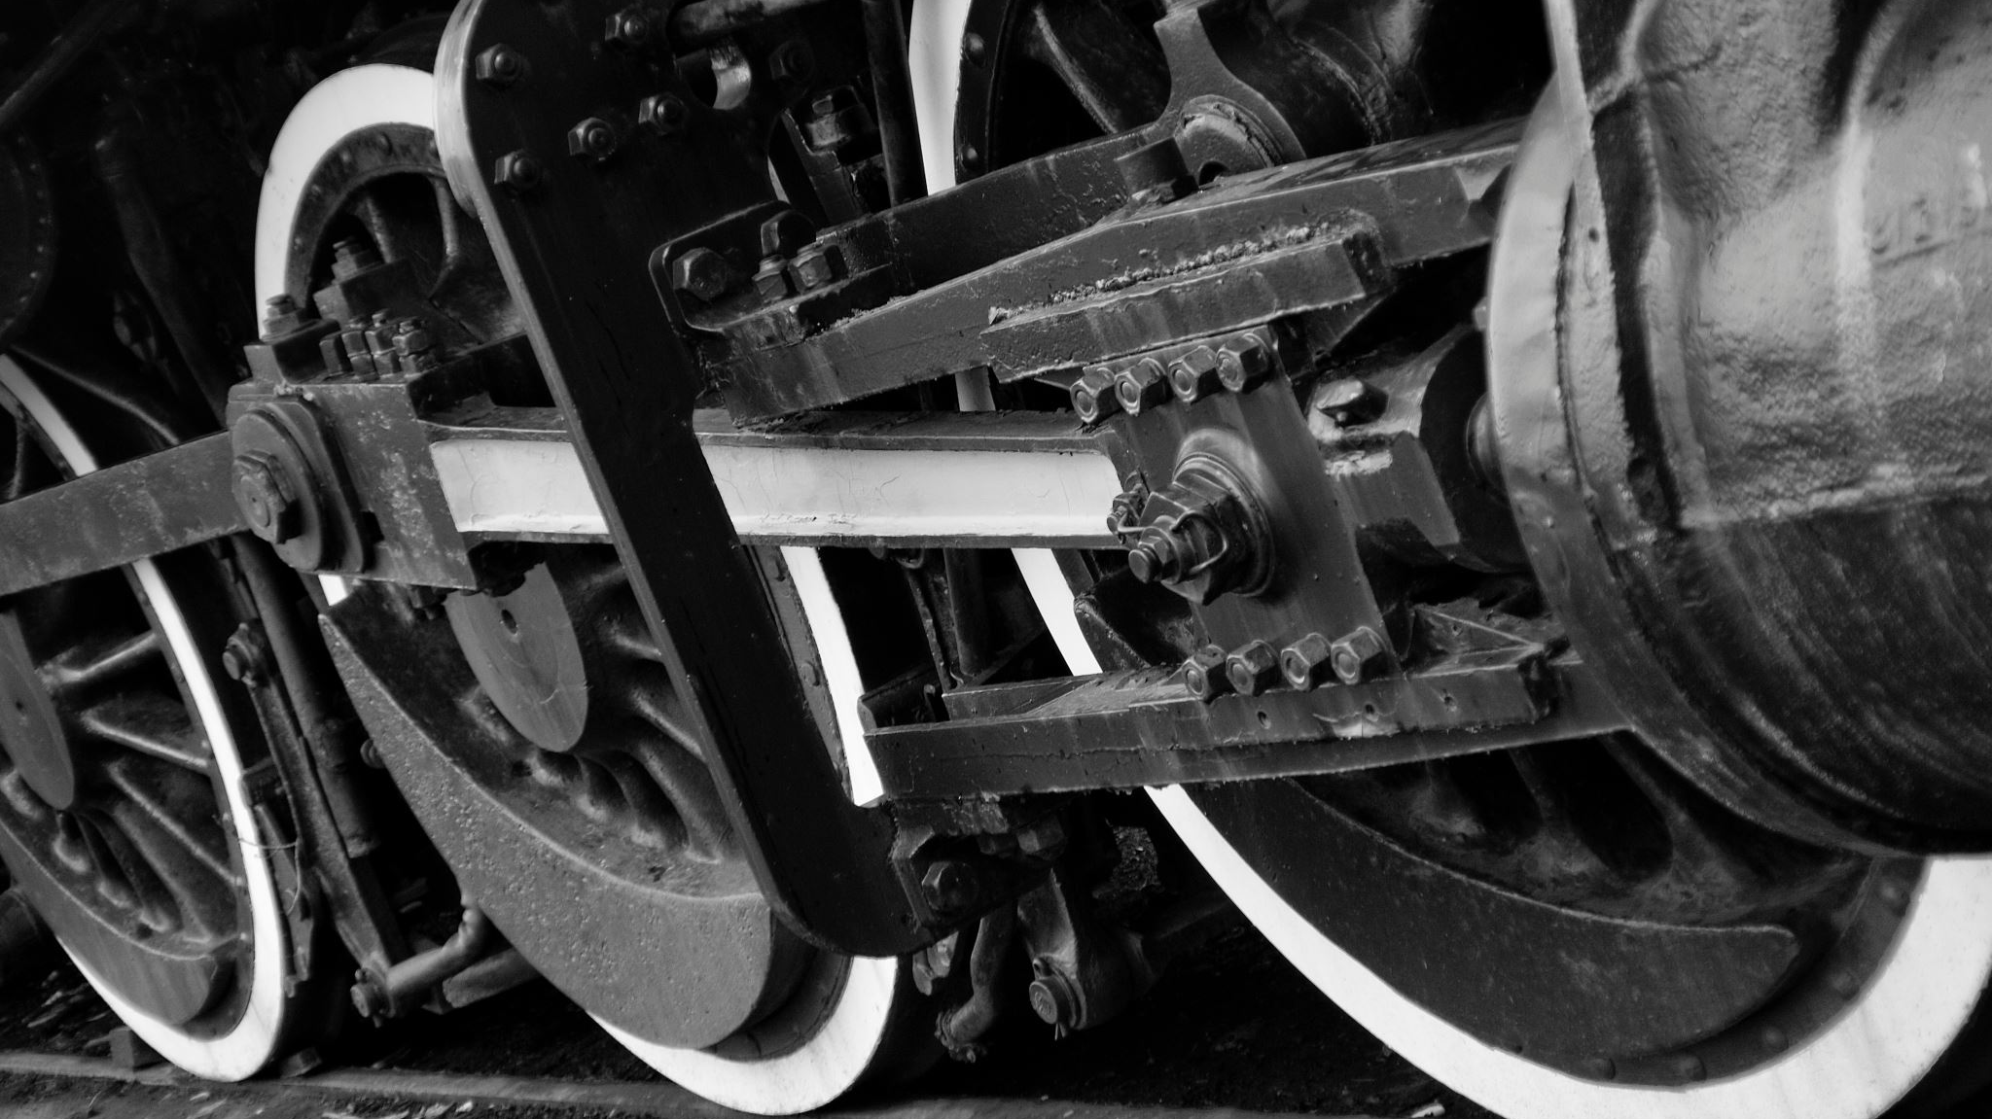
Micah 4: 3-4, “He will judge between many peoples and will settle disputes for strong nations far and wide. They will beat their swords into plowshares and their spears into pruning hooks. Nations will not take up sword against nation, nor will they train for war anymore. Everyone will sit under their own vine and under their own fig tree, and no one will make them afraid for the Lord Almighty has spoken.”

