Slide 1
Bethany Deaf Assembly www.BethanyDeafAssembly.com
Sermons | Berean Studies | Retreat | Calendar | Give

Slide 2
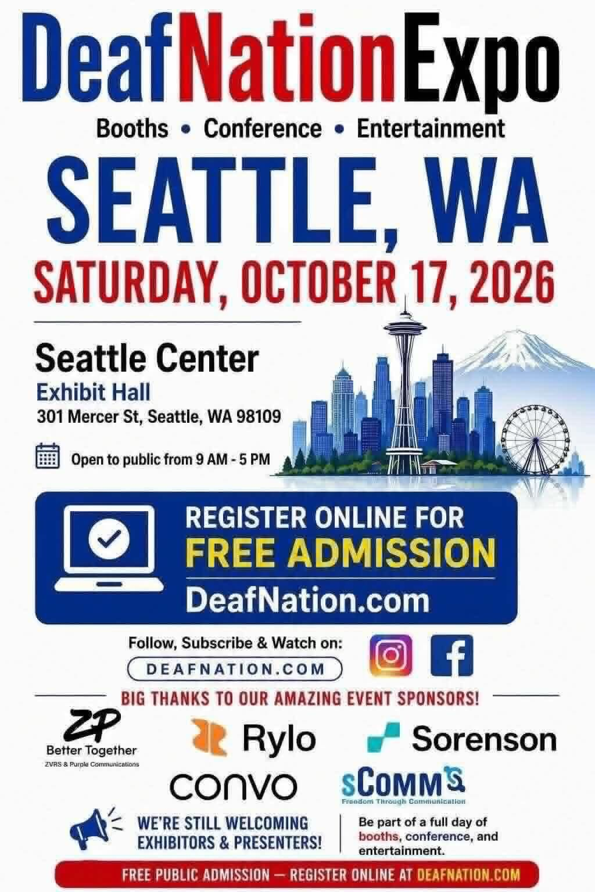


Slide 3

Need Volunteers
Arlington High School
Saturday, Nov 14, 2026
9:00 AM – 5:00 PM
Help Judge ASL Students
Lunch is provided

Slide 4
Psalms 22:1-31

Slide 5
Opening cry of abandonment
Psalms 22:1-2 NLT
1 My God, my God, why have you abandoned me? Why are you so far away when I groan for help?
2 Every day I call to you, my God, but you do not answer. Every night I lift my voice, but I find no relief.
Notes:
Jesus quotes this exact line from the cross (Matthew 27:46; Mark 15:34).

Slide 6
Humiliation, mockery, and scorn
Psalms 22:6-8 NLT
6 But I am a worm and not a man. I am scorned and despised by all!
7 Everyone who sees me mocks me. They sneer and shake their heads, saying,
8 “Is this the one who relies on the LORD? Then let the LORD save him! If the LORD loves him so much, let the LORD rescue him!”
Notes:
Crowds, religious leaders, and even the criminals crucified with Jesus mocked Him, shook their heads, and taunted Him to come down from the cross if God truly delighted in Him (Matthew 27:39–44; Mark 15:29–32; Luke 23:35–39). The wording of the mockery in Matthew 27:43 closely echoes verse 8.

Slide 7
Physical agony of crucifixion
Psalms 22:14-15, 17 NLT
14 My life is poured out like water, and all my bones are out of joint. My heart is like wax, melting within me.
15 My strength has dried up like sunbaked clay. My tongue sticks to the roof of my mouth. You have laid me in the dust and left me for dead.
17 I can count all my bones. My enemies stare at me and gloat.
Notes:
These describe the physiological effects of crucifixion—dislocated joints from the hanging position, extreme dehydration and thirst (Jesus said “I thirst” — John 19:28), circulatory collapse, and exposure. His body was visible and stared at; the soldiers did not break His legs because He was already dead (John 19:33), allowing “all his bones” to remain intact.

Slide 8
Piercing of hands and feet
Psalms 22:16 NLT
16 My enemies surround me like a pack of dogs; an evil gang closes in on me. They have pierced my hands and feet.

Slide 9
Dividing of garments and casting lots
Psalms 22:18 NLT
18 They divide my garments among themselves and throw dice for my clothing.
Notes:
Matthew 27:35; Mark 15:24; Luke 23:34; John 19:23–24

Slide 10
Surrounding enemies described as animals
Psalms 22:12-13, 16, 20-21 NLT
12 My enemies surround me like a herd of bulls; fierce bulls of Bashan have hemmed me in!
13 Like lions they open their jaws against me, roaring and tearing into their prey.
16 My enemies surround me like a pack of dogs; an evil gang closes in on me. They have pierced my hands and feet.
20 Save me from the sword; spare my precious life from these dogs.
21 Snatch me from the lion’s jaws and from the horns of these wild oxen.

Slide 11
Salvation
Psalms 22:19-21 NLT
19 O LORD, do not stay far away! You are my strength; come quickly to my aid!
20 Save me from the sword; spare my precious life from these dogs.
21 Snatch me from the lion’s jaws and from the horns of these wild oxen.

Slide 12
Praise and Worship
Psalms 22:22-26 NLT
22 I will proclaim your name to my brothers and sisters. I will praise you among your assembled people.
23 Praise the LORD, all you who fear him! Honor him, all you descendants of Jacob! Show him reverence, all you descendants of Israel!
24 For he has not ignored or belittled the suffering of the needy. He has not turned his back on them, but has listened to their cries for help.
25 I will praise you in the great assembly. I will fulfill my vows in the presence of those who worship you.
26 The poor will eat and be satisfied. All who seek the LORD will praise him. Their hearts will rejoice with everlasting joy.

Slide 13
Lord and King
Psalms 22:27-31 NLT
27 The whole earth will acknowledge the LORD and return to him. All the families of the nations will bow down before him.
28 For royal power belongs to the LORD. He rules all the nations.
29 Let the rich of the earth feast and worship. Bow before him, all who are mortal, all whose lives will end as dust.
30 Our children will also serve him. Future generations will hear about the wonders of the Lord.
31 His righteous acts will be told to those not yet born. They will hear about everything he has done.

Slide 14
Nature Reveals God
Romans 1:19-20 NLT
19 They know the truth about God because he has made it obvious to them.
20 For ever since the world was created, people have seen the earth and sky. Through everything God made, they can clearly see his invisible qualities—his eternal power and divine nature. So they have no excuse for not knowing God.

Slide 15
The Crimson Worm

Slide 16
Timeline
Remember…
Psalms 22 written ~1,000 years before Jesus’ crucifixion.
Roman crucifixion did not exist yet.
David wrote Psalms 22.
Biblical scholars say that Psalms 22 is a prophecy for the crucifixion.

Slide 17
Worm
Psalms 22:6 NLT
6 But I am a worm and not a man...
Worm = tola (Strong #8438)
When the worm is crushed, produces a vivid red dye.

Slide 18
Crimson Dye
As Offerings Exodus 25:4
Tabernacle Coverings and Curtains Exodus 26-27
High Priest's Holy Garments/Breastplate Exodus 28, 29
Veil of the Tabernacle/Temple Exodus 26, 36
Rahab's Thread Joshua 2
Sin Isaiah 1:18
Jesus' Robe Matthew 27:28

Slide 19
Crimson Worm
When it’s time to give birth, climbs an oak tree.
Gives birth to hundreds to thousands of eggs into a protective chamber within her body. Egg incubation is roughly 4-6 weeks.
Eventually, the mother dies and discharges a crimson dye.

Slide 20
Sacrifice
1 John 3:16 NLT
16 We know what real love is because Jesus gave up his life for us. So we also ought to give up our lives for our brothers and sisters.

