Slide 1

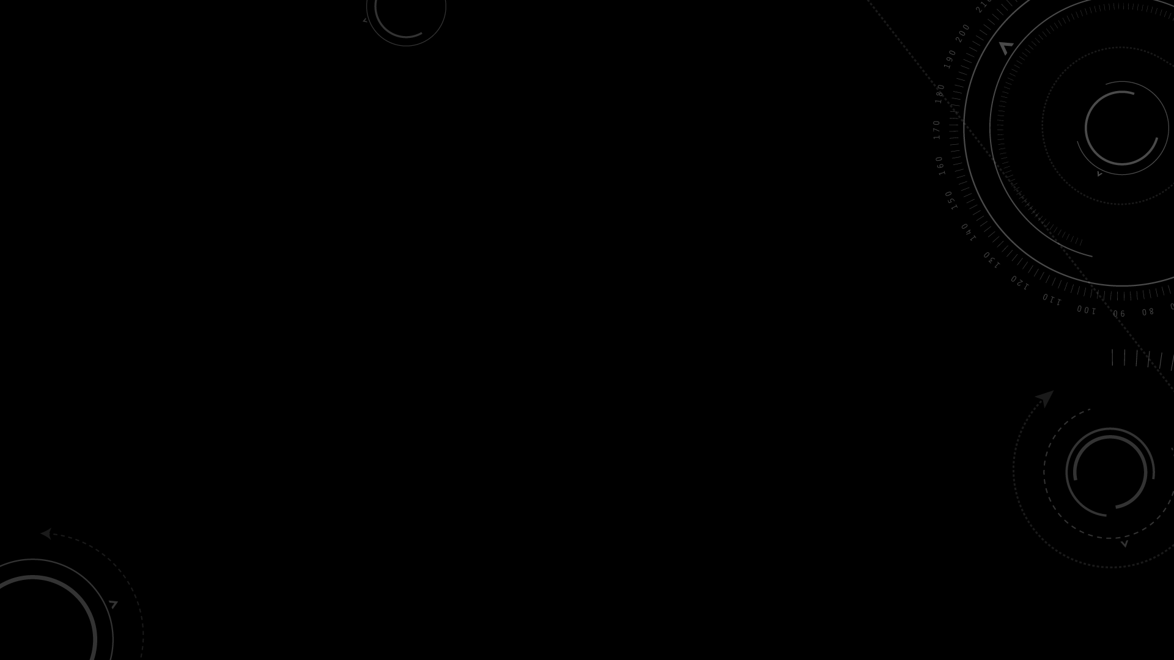
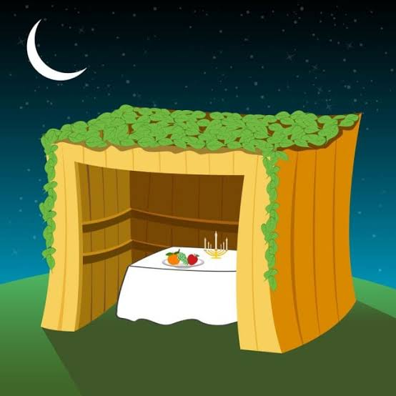
Feast of Tabernacles
(sukkot)
Leviticus 23: 33 - 42

Slide 2
Lev. 23: 33 - 42
“And the Lord said to Moses, ‘Say to Israel: On the 15th day of the 7th month (Tishri) the Lord’s festival of Tabernacles begins and it lasts 7 days. The first day is a sacred assembly, do no regular work.
For 7 days present food offerings and on the 8th day hold a sacred assembly and present a food offering to the Lord. It is the closing special assembly; do no regular work.
...the 1st day is sabbath rest, and the 8th day also a sabbath rest...take branches from palms, willows, and other leafy trees and rejoice before the Lord your God for 7 days. Celebrate this as a festival as a festival to the Lord for 7 days every year... “#8: new beginnings”

Slide 3
Live in temporary shelters for 7 days: All native-born Israelites are to live in such shelters so your descendants will know that I had the Israelites live in a temporary shelters when brought them out of Egypt.
I AM the Lord your GOD!”

Slide 4
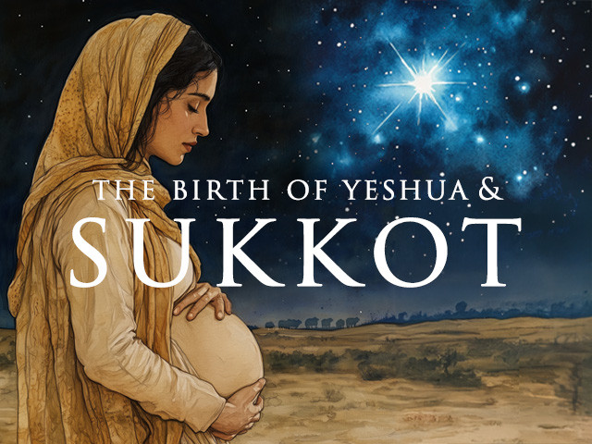
Sukkot is still celebrated by faithful Jewish believers – Sept. 25 – Oct 2, 2026 – a feast of joy, happiness, and community unity
Celebrates the Fall harvest and the 40 years of living in temporary shelters during their journey in the desert to the Promise Land
Build a sukkot (shelter) with plant material you can eat and sleep under
Wave bundle of specific branches and fruit (citrus fruit, palms, myrtle and willow branches)
*A symbol of Jesus’ incarnation...God living in a temporary shelter – the human body... Now we are a living sukkot...Jesus living in us!

Slide 5
The Feast of Tabernacles emphasized God dwelling with and in us!
Ironic! The one mention of the Feast of Tabernacles (John 7: 1 – 39) is one of conflict and confusion until the last day (8th day) Jesus stood and spoke with a loud voice...
V 1-9: In Galilee, Jesus’ brothers taunt Him...everyone who wants attention will go to the Feast to draw people’s attention!
V10-13: His brothers go to Jerusalem and the Jewish leaders are looking for Jesus wanting to kill Him.
V14-24: On the 4th day of the Feast, Jesus goes to Jerusalem and taught in the Temple...He tells the religious leaders, “you want to kill Me for healing on the Sabbath, yet you circumcise a child on the Sabbath! Stop judging by appearance but judge correctly!”

Slide 6
John 7 continues...
V25-39 Division and confusion! Who is this man Jesus?
^{v37-39} On the last day (8th day) and greatest day of the festival (celebration of new beginnings), Jesus stood and said in a loud voice, “Let anyone who is thirsty come to Me and drink. Whoever believes in Me, as Scripture has said, ‘rivers of living water will flow from within them.’”
³⁹By this He meant the Spirit...

Slide 7
Could it be??? ...
When Paul said, “For in Christ all the fullness of the Deity lives in bodily form (pitched tent) and in Christ you have been brought to fullness.” (Col 2: 9-10)
When Paul said, “Now you are the Body of Christ and each one has a part of the Body...” (I Cor 12: 12-27)

Slide 8
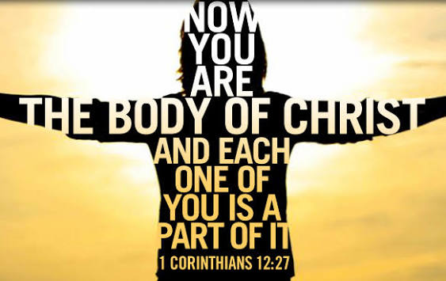
Jesus is our Sukkot
We are in Jesus
And
As the Body of Christ
You are a
Sukkot!

