Slide 1
Acts 2 Model: a blueprint for a healthy church
MIN 171 A Spirit-Empowered Acts 2 Ministry Model
Notes:
Spirit-Empowered church
Take a moment or two to look around to see who is here, I mean really look
Rod and JoAnn won’t be around much longer… what will we do if they’re gone within 6 months? Are we going to just look for another pastor? Or will we develop a health church that we can produce a leader of the church?
Any questions, please take notes for July 26 especially some of your questions may be answered by the book

Slide 2

A Spirit-Empowered Church by Alton Garrison
Amazon.com
ThriftBooks.com
ChristianBooks.com
AltonGarrison.com
ISBN: 978-1-68154-001-6
Notes:
I want all of you to buy this book as I’ll be sharing starting July 26 during Deep Dive
I’m only one part of this whole thing… I can’t do this without you all…
We leaders in the church can’t keep spoon-feeding you if you’re not going to grow in the Lord with His help… spoon-feeding and catering to your needs will burn us leaders out

Slide 3
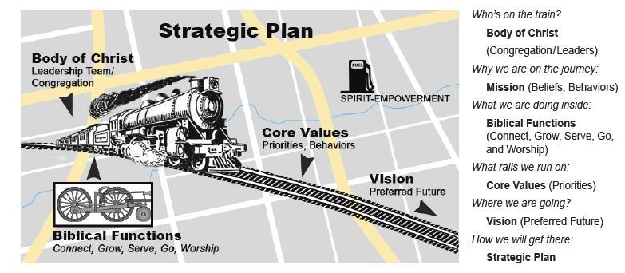
Holy Spirit
fff
Notes:
Two GCs
1 Corinthians 12:12-31 – “I don’t need you”
General Council means nothing without the Holy Spirit…
You will write your mission, your vision statement, and your core values and present it to the board for them to come up with a strategic plan that involves all 5 functions of the church
Mark 12:30-31
Luke 10:27
Deut 10:12, 11:13, 13:3

Slide 4
Acts 2:4
And they were all filled with the Holy Spirit and began to speak in other tongues as the Spirit gave them utterance.
Jesus kick-started the church with His Holy Spirit

Slide 5
Acts 2:14-41
³⁷ Now when they heard this they were cut to the heart, and said to Peter and the rest of the apostles, “Brothers, what shall we do?” ³⁸ And Peter said to them, “Repent and be baptized every one of you in the name of Jesus Christ for the forgiveness of your sins, and you will receive the gift of the Holy Spirit.
Peter preaches the message of the church

Slide 6
Acts 2:42-47
⁴² And they devoted themselves to the apostles' teaching and the fellowship, to the breaking of bread and the prayers. ⁴³ And awe came upon every soul, and many wonders and signs were being done through the apostles. ⁴⁴ And all who believed were together and had all things in common. ⁴⁵ And they were selling their possessions and belongings and distributing the proceeds to all, as any had need. ⁴⁶ And day by day, attending the temple together and breaking bread in their homes, they received their food with glad and generous hearts, ⁴⁷ praising God and having favor with all the people. And the Lord added to their number day by day those who were being saved.
5 functions of the church
Notes:
Homework – find all 5 functions in Acts 2:42-47 (minimum of 3 activities for each function in the 6 verses)
Book doesn’t pinpoint them at all, so it will force you to find them

Slide 7
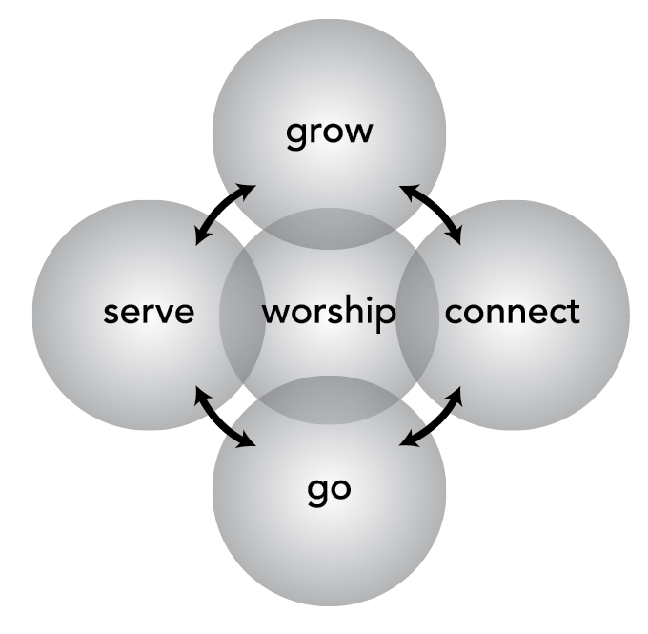
Acts 2:42-47 functions of the church
Fellowship (connect)
Discipleship (grow)
Ministry (serve)
Evangelism (go)
Worship
Notes:
Can be applied individually… course doesn’t talk about it though, but important to do it individually and corporately… we need the body of Christ to fully realize our potentials
Each of the 5 functions are EQUALLY important
Fellowship includes evangelism as well because connect is about growing relationships not only on the inside but on the outside
Ministry – includes outside where we have outreaches and caring for the community
Worship – is words about Him… includes preaching, teaching not just corporate praise and singing… it’s not just music and singing… that’s one of the MANY
expressions of worship – worthship
If someone says he’s not getting anything out of the worship experience, he has the wrong focus… should be on the Holy Spirit, not on the experience itself
All the 5 functions serve the vision of God which ALWAYS includes people → we should always do the 5 functions for the sake of people, not only on the inside but most importantly on the outside –
Are we a church that makes people, both the unchurched and churched, feel like they belong?
Are NOT multiple choice
Discipleship is something that enables you to grow and transform in the Lord… everything else around you will fade, including your body, but what’s transformed in you will last for all eternity
Discipleship requires a lifestyle of fresh encounters with Jesus, never getting too busy working for Him that we lose our relationship with Him
Imagine a church of believers who’ve never learned to feed themselves on His word or to clothe themselves in the righteousness of Christ?
It’s easier to measure converts than it is to measure discipleship because discipleship is a lifelong journey crafted by God in an unique way while conversion is a one-time thing
Discipleship is required in the Great Commission
Discipleship should produce the church of our vision
Discipleship is HARD work – look at how Jesus had to handle His 12 disciples
Evangelism can become counterproductive to God’s purpose for the church when it’s not partnered with discipleship… they’re inseparable – this strongly resonates with my SH curriculum where we allow so many Christians into church without discipling them first… they carry around all this baggage with them and when they do get into ministry, it would implode on them, resulting in damaged relationships, damaged trust, damaged identity representing Christ
Worship should start even before you enter church and continue even when you leave church!

Slide 8
What’s your mentality of church?
Unbelievers – have yet to receive Jesus as their Lord and Savior, don’t follow the Great Commission or Great Commandment
Believers – who have received Jesus as their Lord but have not yet become learners who obey God’s Word (behavior) – focus on Great Commission, but not Great Commandment
Disciples – people who adhere to the teachings and practices of growing in Christ and demonstrate a lifestyle corresponding to God’s word, follows both the Great Commission and Great Commandment
What are you in the Kingdom of God?
Notes:
Believers can point to God and have biblical knowledge, but they’re no different than the demons who can do the same, but what they don’t have is the love of God in them, and some believers don’t

Slide 9
What’s your mentality of church?
Servant Leaders – people who have grown in the direction, ways, and timing of the Lord and share their knowledge of Christ with others so they, too, can learn His direction, ways, and timing… involved in different aspects of church life (bus drivers, altar workers, greeters, deacons, Sunday school teachers, etc.)
Reproducers – people who mentor others through relationship to the point where they become servant-leaders
What are you in Kingdom of God?
Notes:
When churchgoers realize they don’t come to church to receive ministry, but to also minister, that’s when the church starts to get healthy
The moment you realize you don’t have anything to offer is the moment where you should start your relationship with the Holy Spirit
Ephesians 4:12 – we leaders are responsible for equipping the saints for the work of ministry, for the edifying of the body of Christ
JoAnn captured my heart for Acts 2 journey, so she is equipping me for ministry because she saw that my heart is stirred… we should do the same for each other!
Think of it as an investment where you get a “return”… you have ownership of the church, you have a “buy-in” into the church… you are “partnering” with the One and others to help grow the church… you have a stake in it… you don’t just sit back and relax and just “help”… you are diligently invested in the church
Bring up about the business with Michael and Julia… equate it to ownership
Churches/laymen rarely go beyond that of their leaders, so it’s imperative that we equip the believers for the work of ministry
When someone asks what you do in church? “Oh I just go, I’m not involved”… will that inspire a sense of belonging to the newcomers? Can you tell people who you are? Do you have the confidence to tell people that you serve a mighty God and have amazing relationships with others?

Slide 10
Why do you come to church?
Place – “that’s my church because I’ve experienced the most significant moments/events there!”
Personality – “that’s my pastor!”
Programs – “love that kids’ ministry!”
People – “my friends are there!”
Position – “I’m a leader at the church!”
Notes:
Place – This can be an impediment to change as people prefer to “keep” the memories or the “look”/”feel” of the church
Personality - Can be to anyone, or have a connection with the ministry leadership
Programs - Bible studies, youth gatherings, etc.; Until things change… the times, the type of ministry, the leadership, etc.
People – until friends move to another church
Position – have something to do at the church, a level of ownership – what if someone else takes over your position or your job changes?
All 5 reasons can be affected by change in the church, so what do we do?

Slide 11
Why do you come to church?
Purpose – a sense of belonging because the church has a purpose for everyone to get involved and be part of what God is doing in the church/community
Notes:
Purpose allows change to happen
We should move to a concept of “leaders-helpers” to a “team ministry” where everyone has a sense of ownership and belonging/connection to do something good and give input on how to make things better

Slide 12
Royal Priesthood
But you are a chosen race, a royal priesthood, a holy nation, a people for his own possession, that you may proclaim the excellencies of him who called you out of darkness into his marvelous light.
1 Peter 2:9
We all minister to someone in our lives
Notes:
You have both royalty and priesthood… you have both authority and the ability to minister… you are called by God because you have access to Him and offer not external, but spiritual sacrifices (#2406 Strong’s)
I also like one of the definitions of Strongs’ – priests of kingly rank where you are exalted to a moral rank and freedom which exempts you from the control of everyone but God and Christ
Why are you coming to church? Do you know what your purpose is in His Kingdom? 3 E’s – enable, empower, exhort… one can’t exhort someone without empowering them, one can not empower someone without enabling them and one can not enable someone without introducing them to Jesus, His Kingdom, and His Word.
This is a biblical mandate… you are already called, chosen to be a priesthood and princes/princesses, so it’s not a volunteering thing to do plus we can’t develop into Jesus’ likeness unless we are serving in His Kingdom
When we all grasp the idea that we are priests, we will feel we are not alone… we don’t view each other as “helpers”, but with priests who are overflowing with love, forgiveness, and the power of the Holy Spirit – causing a greater sense of ownership
Concept and application of the priesthood is a catalyst for the Acts 2 Model … the model doesn’t work without that shift in attitude of being co-owners…
So do you feel like a co-owner when you come into church?
We cannot build disciples in our churches until we first experience this empowerment of the Spirit ourselves and demonstrate it to a hungry world
Linda’s teaching on the “power of one”
Together can not occur if one person does not want to volunteer… it begins with one person… the power of one person can hinder/thwart or enable God’s plans
God has used individuals to change the course of history, most of them unlikely candidates, but they were humble enough to know that their inadequacy and God’s adequacy were enough to make change
Even one person who is cynical or skeptical can be a critical factor in helping the church move in a different direction, where even that success or failure can rest on that one person
It’s about who you are and what you are doing in His Kingdom right now
A Christian who is not a minister is an oxymoron
We go to church to meet needs rather than get our needs met, especially since we’re a priesthood of believers

Slide 13
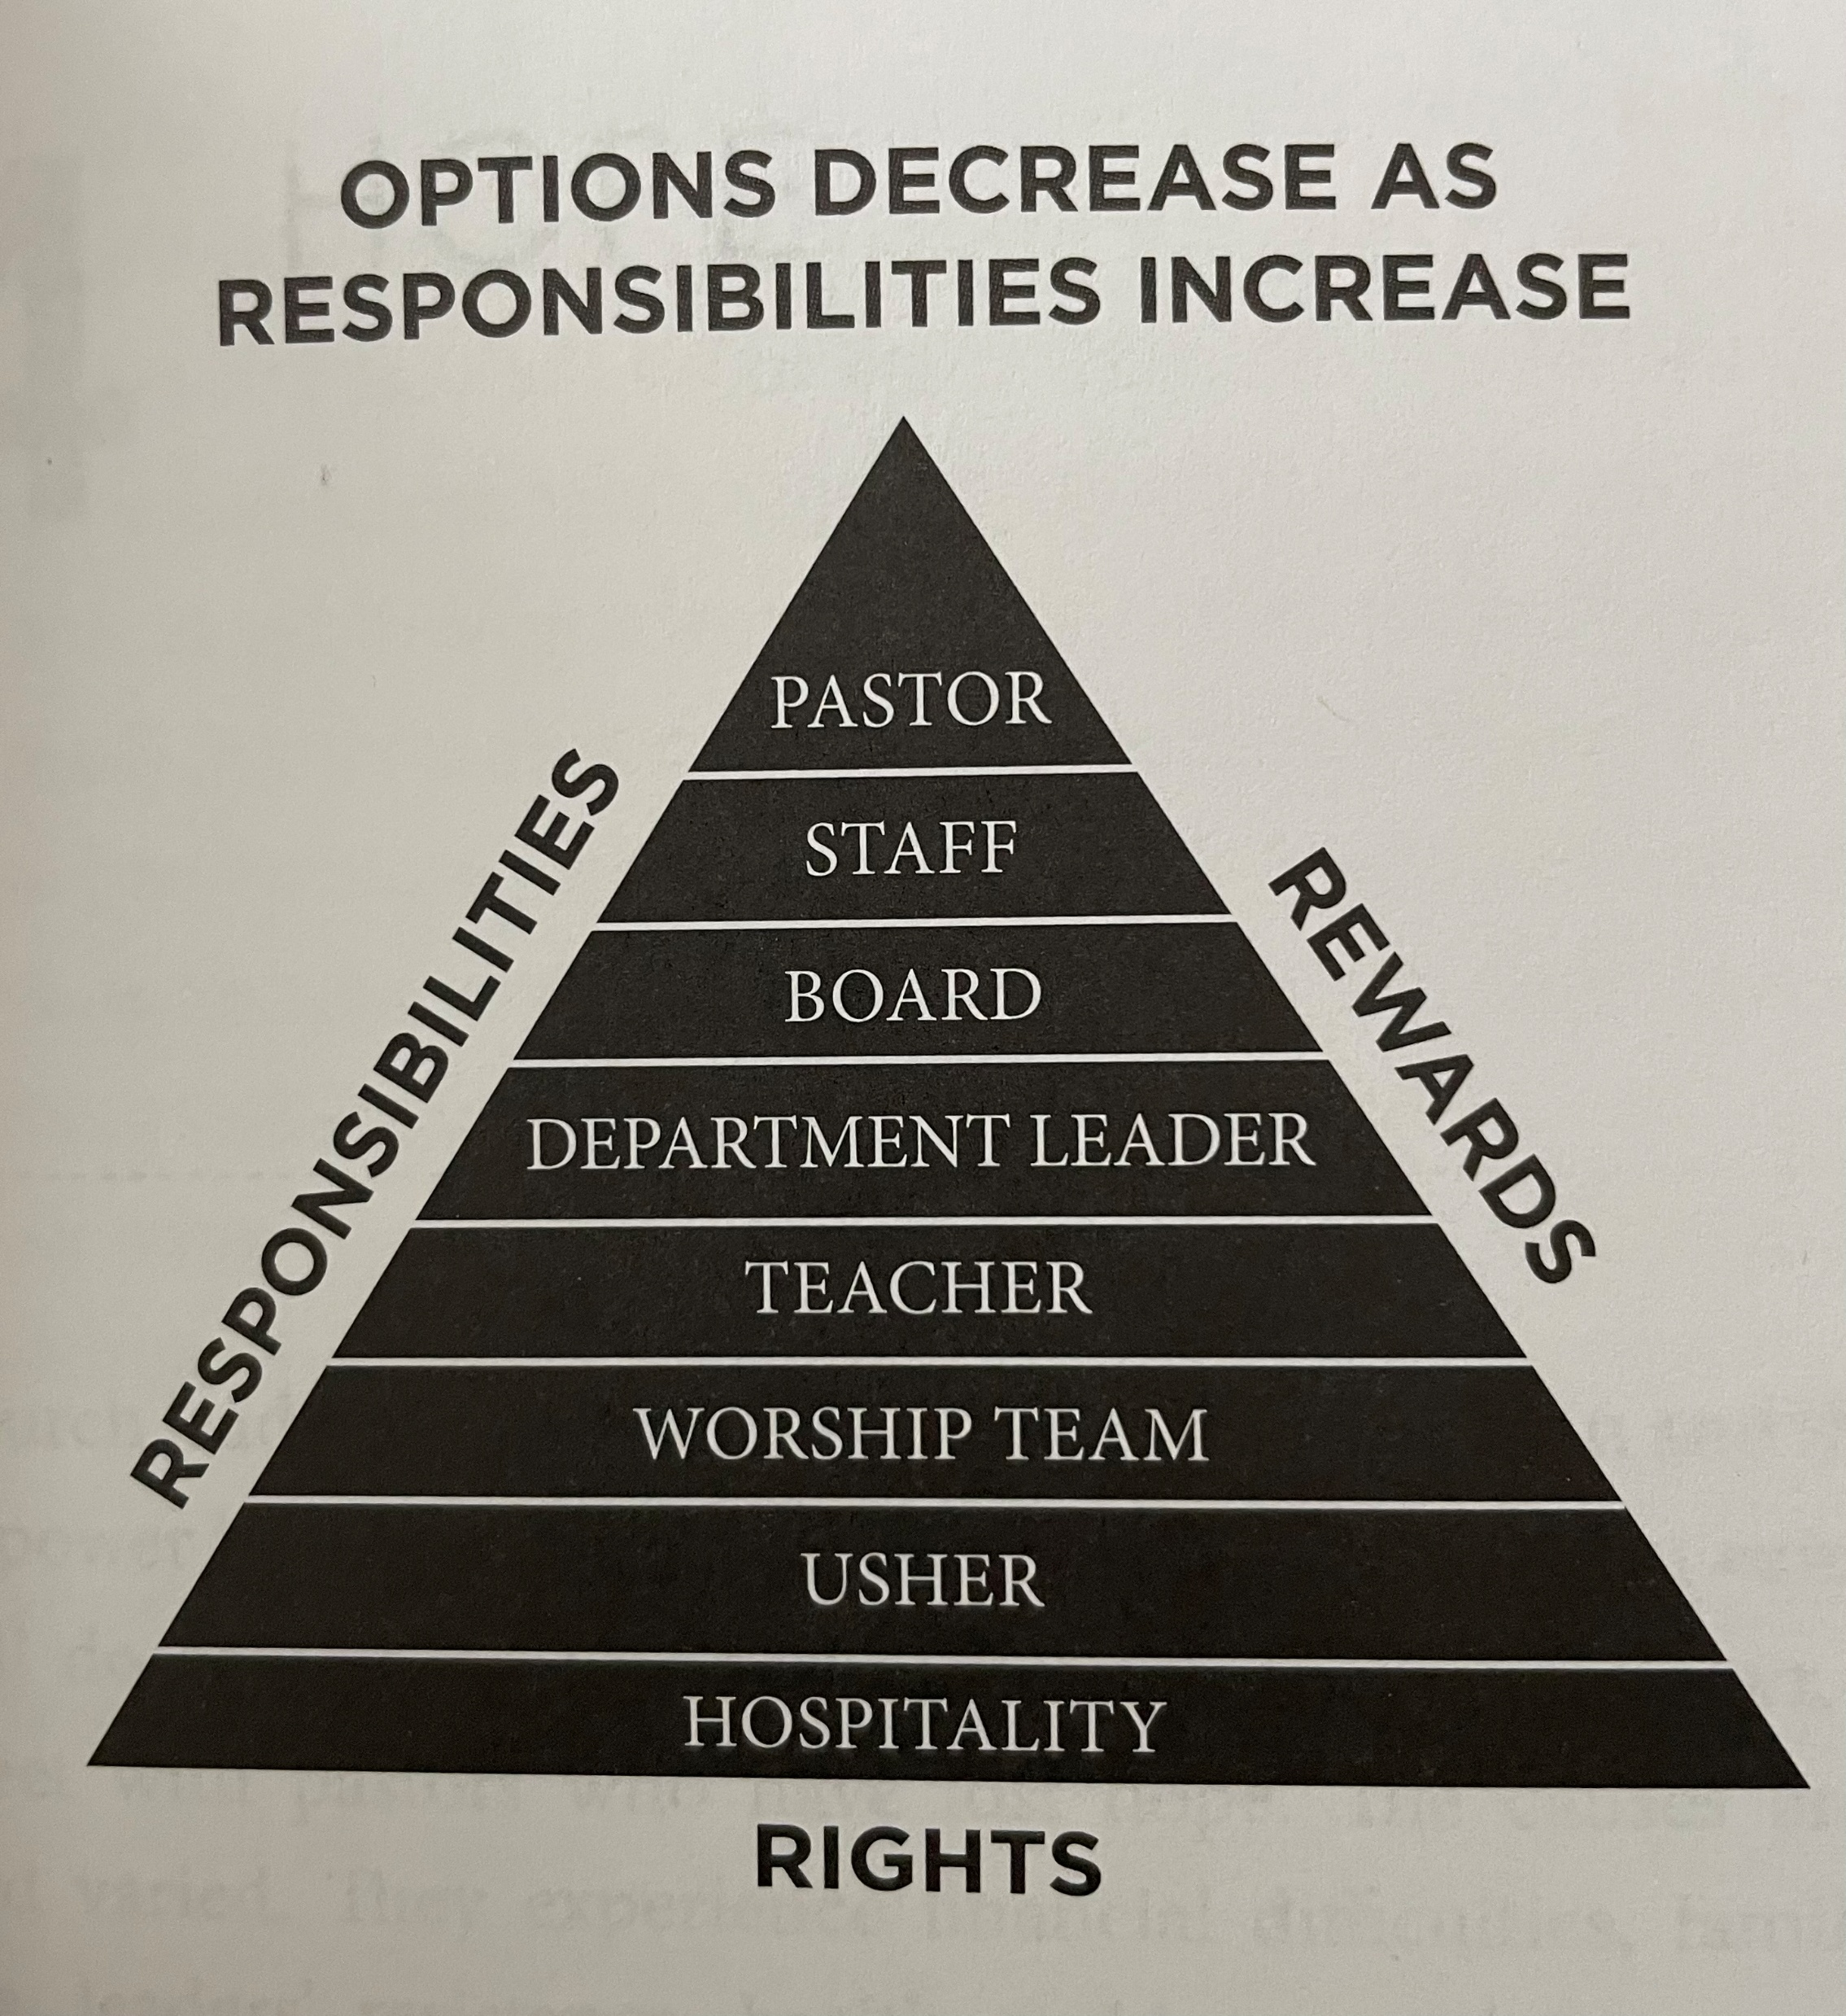
Culture of service and ownership
Ephesians 4:11-12
And he gave the apostles, the prophets, the evangelists, the shepherds and teachers,¹² to equip the saints for the work of ministry, for building up the body of Christ…
Notes:
Our primary role is to equip the saints for ministry – Ephesians 4:11-12 - And he gave the apostles, the prophets, the evangelists, the shepherds^{[c]} and teachers,^{[d]} ¹² to equip the saints for the work of ministry, for building up the body of Christ,
Humility is a requirement for servitude to prevent it from getting to our heads, so we should produce it in the people we disciple as well

Slide 14
Holy Spirit
He’s not spontaneous
He has always had a plan, even before the foundation of the world
He’s orderly
He grieves
He wants a relationship with you
He has the power to transform you
Jesus gave us two commands with the help of the Holy Spirit
Ephesians 5:18
And do not get drunk with wine, for that is debauchery, but be filled with the Spirit…
Notes:
He has a plan for us already… He’s waiting for us to partner with Him… this is why this process is critical for us transitioning to a General Council church because we will need all the help from Him to function and maintain as a church
We tend to act like anything from the Holy Spirit is last minute and taking plans is antithetical (in opposition) to being led by the Spirit
Ephesians 1:4 - even as he chose us in him before the foundation of the world, that we should be holy and blameless before him.
Time to change our thinking that any plan that we come up with doesn’t jive with the Holy Spirit… He wants to PARTNER with us!
1 Corinthians 14: 40 - But all things should be done decently and in order.
Ephesians 4:30 - And do not grieve the Holy Spirit of God, by whom you were sealed for the day of redemption.
2 Corinthians 3:18 - And we all, with unveiled face, beholding the glory of the Lord, are being transformed into the same image from one degree of glory to another. For this comes from the Lord who is the Spirit.
I believe His heart is softest kind around that we will ever experience – look how He made man in His own image… He formed him out of the ground… likely with His (Jesus?) own hands… He could have spit on the ground and *poof* formed Adam… but, no, it was a personal workmanship of God’s… we are His greatest creation… it was up close and personal! Look what He did even after we sinned… He clothed us with, again, His own hands!!! He didn’t shy away from us… that’s why we should be in a personal intimate relationship with Him… same as the SH curriculum I’ve developed
“As the enemy shouted lies in my ear, the Holy Spirit quietly whispered truth to my soul.”
Unfortunately the world has made a caricature of God, making Him aloof, apathetic, distant, angry, mean, smug, etc.
Vision is in the heart of God… He offers it to your spirit through His Holy Spirit and He is waiting for you to draw it out and act on it
The 3 E’s – validates my being led by the Holy Spirit all this time… I’m not perfect as evident by my two failed marriages, but the Holy Spirit will never leave me nor forsake me (Hebrews 13:5), so He has stirred my heart in the 3 E’s which was a small picture of what this process is all about…
I’m listening to the HS… I’m being led by the HS…
Are you being led by the Spirit? How do you know you’re being led by the Spirit?
Having a relationship with God, Jesus, and the Holy Spirit requires a relationship with the Holy Spirit
John 14:6 - “I am the way, and the truth, and the life. No one comes to the Father except through me.
John 6:44 - No one can come to me unless the Father who sent me draws him. And I will raise him up on the last day.
John 16:7 - Nevertheless, I tell you the truth: it is to your advantage that I go away, for if I do not go away, the Helper will not come to you. But if I go, I will send him to you.
If you want to connect with God, you have to go to Jesus, and to go to Jesus you need to open up to the Holy Spirit calling you by the Father
If you aren’t connecting with people, then look at your heart to see if you have the love of God in your mind, your soul. If you have the love of God in you, you can’t help but tell them about Jesus.
God is molding us into becoming like Him… it’s the only nature that’s pleases Him… that’s why He can’t tolerate anything else and which is why we are suffering because we are not like Him… that’s why He’s more concerned with molding us into His likeness of His beloved Son than with shielding us from discomfort.
We may pray… Lord change my circumstances… but He ends up wanting to change us.
2 Corinthians 4:17 - For this light momentary affliction is preparing for us an eternal weight of glory beyond all comparison…. Meaning our affliction is working our glory
We can pray for the power of the Holy Spirit, by asking ourselves hard questions about the condition of our hearts and listening to the Spirit’s truthful answers

Slide 15
Most valuable commodity of the church
People
Are people viewed as ASSETS or OBSTACLES?
We need to invest in relationships in the church and outside in order to have any sense of ownership
Notes:
Something beneficial or valued
People walking through the door are the most valuable commodity of the church, so when people are embraced in relationship and promoted in their relationship with Jesus then they will feel a call on their lives
We need to invest in relationships in the church and outside in order to have any sense of ownership… you will feel invested and part of things
Feeling of ownership shouldn’t led to entitlement – sense of feeling owed something in exchange for service, rights to benefits or privileges - this is where humility is important and that’s where the Spirit of God forms in each of us so it will last forever
Jesus said in Matthew 23:11 - The greatest among you shall be your servant. And Matthew 20:26-28 - It shall not be so among you. But whoever would be great among you must be your servant,^{[c]} ²⁷ and whoever would be first among you must be your slave, ²⁸ even as the Son of Man came not to be served but to serve, and to give his life as a ransom for many.”

Slide 16
Strategic Plan for BDA
Know our mission
Know our vision
Know our core values
Develop a strategic plan to reach the vision
  Getting to where you are (your values) to where you want to go (your vision)
Notes:
Having a plan does not replace passion for God, but shapes the passion into a focused plan then executes the plan
Having relationships is what makes the mission human
Visions always invites risk and criticism that’s why it’s important to be on the same page and be in one accord to the vision
We established that our mission is universal, we began to build a vision around people, and we identified the core values and behaviors that reflect those values. Now, it is time to put it all together into a strategic plan that will help you get from where you are (your values) to where you want to go (your vision).
I have assessment sheets that the board will fill out…. We need to be honest and sincere in our assessments…

Slide 17
Holy Spirit
fff
Notes:
New visitors need their sense of belonging met… that comes before belief and becoming… as family starts when people feel a sense of belonging… and that’s just the beginning
We want disciples to explore truths of the faith in the safety of accepting relationship, which allows belonging before believing
We want unbelievers to feel like they can belong to our church, even though they haven’t accepted Jesus into their hearts… but the belonging can help the believing
We want them to explore God’s truth in a safe place and in a personal way
The only way to seed new life into the church is through new people and new vision… we should incorporate evangelism in our vision otherwise our church will die out
Churches have to be about Him and about “them” – the people outside the church with whom we should be building relationships with

Slide 18
A healthy church is the one that…
Engages and maintains loving relationships (connect)
Develops and mobilizes the people (grow)
Acts with clear direction and outward focus (serve)
Reproduces and multiplies His mission in other peoples and places (go)
Pursues and obeys God passionately (worship)
Without the anointing of the Holy Spirit, the above 5 are just programs
Notes:
Worship – someone who doesn’t like worship – can bring up about how a worship leader paused the music/songs and asked people to fill in the blank “I am so glad that God is ____________” and got a bunch of responses and think about what they want to say and talk with God for a minute… worship is not about singing, it’s about reveling in the presence of God, talking with Him, bantering with Him, and those who can’t sing will be doing just that!
Connect – 5 feet rule
Connect – Vietnamese culture is deeply ingrained in hospitality – always making anyone feel welcome, providing a space for mutual respect and dialogue

Slide 19
Teacup story
This story tells of a woman who saw a beautiful teacup on a shelf. She admired its delicate outline, smooth finish, and lovely design. As she held it, the teacup began to speak:
“I was not always like this,” said the teacup.
“There was a time when I was only a lump of clay — without form, ordinary, and unimpressive. Then my master took me into his hands and began pressing, pounding, and molding me. I cried out, ‘Stop! That hurts!’ But he only answered, ‘Not yet.’”

Slide 20
Teacup story
“Then he placed me on a wheel and spun me around and around until I thought I could bear it no longer. I cried, ‘Please stop! I am dizzy and weary!’ Again he said, ‘Not yet.’”
“Then he put me into a furnace. The heat was unbearable. I was certain I would be destroyed. I cried out, ‘Master, why are you doing this to me?’ But through the fire, I heard his voice repeat, ‘Not yet.’”
“At last, he took me out and set me aside. I thought the suffering was finally over. Then he started to paint me. The fumes were strong, and the brushstrokes felt strange. I did not understand what he was doing. Still, he said, ‘Not yet.’”

Slide 21
Teacup story
“Then came the second furnace, even hotter. I was sure I could not survive this time. But once more, the master knew exactly what he was doing.”
“When he finally brought me out, he set me before a mirror. I could hardly believe what I saw. “I was no longer that rough, unfinished lump of clay. I had become something beautiful, useful, and prepared for his purpose.”
“Then my master said, ‘When I pressed you, you did not understand. When I spun you, you did not understand. When I put you in the fire, you thought I was destroying you. But I knew what I was making the entire time.’”

Slide 22
It starts with humility…
Yet the humility God forms in His suffering servants will endure forever. The faith He strengthens in His agonizing saints will not perish with the pain that produced it. The holiness He cultivates in every believer’s fiery trial will become part of the soul’s everlasting beauty in the land of endless day. The perseverance He develops in His children will outlast the afflictions that required it. And the love He deepens in those who trust the Savior, even when life is dark and providence is hard, will rise as holy praise to the glory of God forever and ever.
Notes:
Providence – divine guidance or care

Slide 23
Ephesians 2:10
For we are his workmanship, created in Christ Jesus for good works, which God prepared beforehand, that we should walk in them.
Enabling
Each one of us as a member of the body of Christ has the opportunity and means to find out and get to know people in a very personal way: their heart, their goals, their desires, their talents, their gifts in His Kingdom. When people can be their true selves, even if they may be the worst of sinners, then they are "activated" to serve in His Kingdom.
Notes:
Enabling - Each one of us as a member of the body of Christ has the opportunity and means to find out and get to know people in a very personal way: their heart, their goals, their desires, their talents, their gifts in His Kingdom. When people can be their true selves, even if they may be the worst of sinners, then they are "activated" to serve in His Kingdom.
Ephesians 2:10 = For we are his workmanship, created in Christ Jesus for good works, which God prepared beforehand, that we should walk in them.
Empowering - Each one of us as a member of the body of Christ has the opportunity and means to create and provide opportunities for people to play a role in ministry, showcasing their talents and gifts that He has given them.
2 Corinthians 9:8 - And God is able to make all grace abound to you, so that having all sufficiency in all things at all times, you may abound in every good work.
Exhorting - Each one of us as a member of the body of Christ has the opportunity and means to encourage and help build on people's roles in ministry through resources, fellowship, support (bearing one another's burdens), and prayer. Much like God, Jesus, and the Holy Spirit ministering to one another, we also minister to one another.
Galatians 6:2 – Bear one another's burdens, and so fulfill the law of Christ.

Slide 24
2 Corinthians 9:8
And God is able to make all grace abound to you, so that having all sufficiency in all things at all times, you may abound in every good work.
Empowering
Each one of us as a member of the body of Christ has the opportunity and means to create and provide opportunities for people to play a role in ministry, showcasing their talents and gifts that He has given them.
Notes:
Enabling - Each one of us as a member of the body of Christ has the opportunity and means to find out and get to know people in a very personal way: their heart, their goals, their desires, their talents, their gifts in His Kingdom. When people can be their true selves, even if they may be the worst of sinners, then they are "activated" to serve in His Kingdom.
Ephesians 2:10 = For we are his workmanship, created in Christ Jesus for good works, which God prepared beforehand, that we should walk in them.
Empowering - Each one of us as a member of the body of Christ has the opportunity and means to create and provide opportunities for people to play a role in ministry, showcasing their talents and gifts that He has given them.
2 Corinthians 9:8 - And God is able to make all grace abound to you, so that having all sufficiency in all things at all times, you may abound in every good work.
Exhorting - Each one of us as a member of the body of Christ has the opportunity and means to encourage and help build on people's roles in ministry through resources, fellowship, support (bearing one another's burdens), and prayer. Much like God, Jesus, and the Holy Spirit ministering to one another, we also minister to one another.
Galatians 6:2 – Bear one another's burdens, and so fulfill the law of Christ.

Slide 25
Galatians 6:2
Bear one another's burdens, and so fulfill the law of Christ.
Exhorting
Each one of us as a member of the body of Christ has the opportunity and means to encourage and help build on people's roles in ministry through resources, fellowship, support (bearing one another's burdens), and prayer. Much like God, Jesus, and the Holy Spirit ministering to one another, we also minister to one another.
Notes:
Enabling - Each one of us as a member of the body of Christ has the opportunity and means to find out and get to know people in a very personal way: their heart, their goals, their desires, their talents, their gifts in His Kingdom. When people can be their true selves, even if they may be the worst of sinners, then they are "activated" to serve in His Kingdom.
Ephesians 2:10 = For we are his workmanship, created in Christ Jesus for good works, which God prepared beforehand, that we should walk in them.
Empowering - Each one of us as a member of the body of Christ has the opportunity and means to create and provide opportunities for people to play a role in ministry, showcasing their talents and gifts that He has given them.
2 Corinthians 9:8 - And God is able to make all grace abound to you, so that having all sufficiency in all things at all times, you may abound in every good work.
Exhorting - Each one of us as a member of the body of Christ has the opportunity and means to encourage and help build on people's roles in ministry through resources, fellowship, support (bearing one another's burdens), and prayer. Much like God, Jesus, and the Holy Spirit ministering to one another, we also minister to one another.
Galatians 6:2 – Bear one another's burdens, and so fulfill the law of Christ.

Slide 26
One cannot exhort someone without empowering them. And one cannot empower someone without enabling them. And one cannot enable someone without introducing them to Jesus, His Kingdom, and His Word.
Notes:
When a ministry has been in 1, 5, 10, or 20 years of existence, everyone in the ministry always has the opportunity for enabling, empowering, and exhorting one another. When all three areas are happening, the Holy Spirit is springing in action and flowing to bring about characteristic traits like accountability, communication, openness, humbleness, willingness, adaptability, and the like which all become the heartbeat of the ministry. The Holy Spirit is in full swing to use His resources and power to reach out to the world, spawning ministries for each and everyone. That kind of ministry can reach out to those who are hurting, downtrodden, rejected, or isolated.

Slide 27
Notes:
When a ministry has been in 1, 5, 10, or 20 years of existence, everyone in the ministry always has the opportunity for enabling, empowering, and exhorting one another. When all three areas are happening, the Holy Spirit is springing in action and flowing to bring about characteristic traits like accountability, communication, openness, humbleness, willingness, adaptability, and the like which all become the heartbeat of the ministry. The Holy Spirit is in full swing to use His resources and power to reach out to the world, spawning ministries for each and everyone. That kind of ministry can reach out to those who are hurting, downtrodden, rejected, or isolated.

