Slide 1
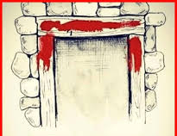
The Passover Festival
Exodus 12: 1 - 14

Slide 2
The Seven (7) OT Feasts/Festivals
Spring Feasts:
  Passover (Pesach)
  Unleavened Bread
  First Fruits
  Feasts of Weeks or Pentecost (Shavuot)
Fall Feasts:
  Trumpets (Rosh Hashanah)
  Day of Atonement (Yom Kippur)
  Feasts of Tabernacles (Sukkot)
Memorials established for us to pause, stop, and ponder...

Slide 3
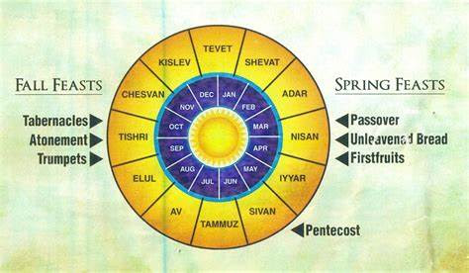
Etc...
#1
#7
#6
#2
#5
#3
#4

Slide 4
Lev. 23: 4 & 5, “These are the Lord’s appointed festivals, the sacred assemblies you are to proclaim at their appointed times. The Lord’s Passover begins at twilight on the 14th day of the first month.”
*The Passover and the Feast of the Unleavened Bread overlaps. Lev. 23: 6, “On the 15th day of that month (the first month) the Lord’s festival of Unleavened Bread begins; for seven (7) days you must eat bread made without yeast...”
*Today we will look at the Passover only...

Slide 5
Miscellaneous Information about the Passover:
Exodus 12: 48 and Numbers 9: 14 instructs non-Jewish (foreigners) were invited to participate in the Passover celebrations
II Chronicles 35: 1 – 18: From Samuel (between 1100 – 1001 bc) to King Josiah (640 - 609 bc) the Passover was barely practiced (roughly 640 years)...Remember, Babylon destroyed the Temple in Jerusalem in 586 bc)
Ezekiel 45: 21 Prophecies Israel and the Passover will be restored.

Slide 6
The Origin of the Passover Feast: Exodus 12
v2 The Lord establishes the Jewish calendar, Nisan is the first month of their calendar.
Passover is to be in the month of Nisan on the 14th day
Each family is to select a male spotless lamb on the 10th of Nisan, take care of it until the 14th then kill it at twilight
(sunset – around 6pm)
Some of the lamb’s blood is to be placed on the door

Slide 7
V8 That night they are to eat the roasted lamb along with bitter herbs (symbolic of their 400+ years of bitter suffering) and bread without yeast (no time to wait for yeast to rise)
  Yeast does not mean ‘sin’ – Jesus used yeast as a symbol of growth
V11 Eat it with your cloak (coat) tucked into your belt (the men tucked their cloaks in their belts only when they are ready to run), sandals on, and staff in hand, eat in haste (a hurry); because it is the Lord’s Passover.

Slide 8
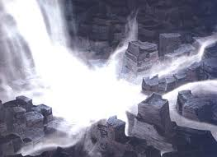
V12 On the same night, I will (not a Death Angel – but God Himself) will pass through Egypt and strike every 1st born of both people and animal and I will bring judgement on all of the gods of Egypt. I Am the Lord!

Slide 9
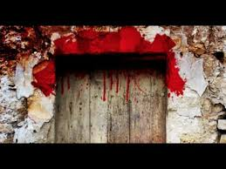
V13 The blood will be a sign for you on the houses where you are, and when I see the blood, I will passover you... No destruction will touch you when I strike Egypt.
V14 This is a day you are to commemorate; for generations to come you shall celebrate it as a festival to the Lord; a lasting ordinance.

Slide 10
¹Who has believed our message and to whom has the arm of the Lord been revealed?
²He grew up before Him like a tender shoot, and like a root out of dry ground. He had no beauty or majesty to attract us to him nothing in his appearance that we should desire him.
³He was despised and rejected by mankind, a man of suffering, and familiar with pain. Like one from whom people hide their faces he was despised, and we held him in low esteem.
⁴Surely he took up our pain and bore our suffering, yet we considered him punished by God, stricken by him, and afflicted.
⁵But he was pierced for our transgressions, he was crushed for our iniquities; the punishment that brought us peace was on him, and by his wounds we are healed.
⁶We all, like sheep, have gone astray, each of us has turned to our own way; and the Lord has laid on him the iniquity of us all. (Isaiah 53: 1 – 6)

Slide 11
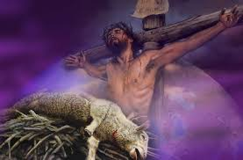
Jesus is our Passover Lamb
I Corinthians 5: 7, “...For Christ, our Passover Lamb, has been sacrificed!”
Hebrews 9: 12, “He did not enter by means of goats and calves; but He entered the Most Holy place once and for all by His own blood, thus obtaining eternal redemption.”

Slide 12
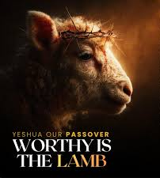
Jesus provided the blood of deliverance
Jesus was/is a sinless sacrifice
Jesus delivers us from our bondage

