Slide 1
Hebrews 11 – The hall of faith!

Slide 2
Faith defined:
Chapter 10 – We are encouraged to not ‘shirk back’; Remember who you are and Whose you are!
V1 “Now faith is being sure of what we hope for and certain of what we do not see.”

Slide 3
“Being sure” = no doubt
“of what we hope for” = I know now what will tomorrow
“certain of what we do not see” – confident or convinced about something. Something that is definite, fixed, or inevitable, beyond doubt.

Slide 4
V2 Faith is what the ancients (former leaders) were known for! They were ‘commended for’ = recognized and congratulated for...
V3 First by faith, we believe God created all things by His command – from nothing, all this was created by His Word
V4 Abel & Cain = Abel, by faith, brought God a better offering: meat vs wheat? Cain knew God as well as Abel and God knew Cain’s heart. Cain’s attitude towards God was disrespectful, his familiarity with God made him hard hearted. Yet Abel’s familiarity made him tender and loving toward God...Abel was called righteous

Slide 5
V5 Enoch was taken and never experienced death. Seen as the person who pleased God – called righteous because of his relationship with God
V6 “...without faith it is impossible to please God because anyone who comes to Him, must believe He exists and that He rewards those who eagerly/diligently seek Him.”
V7 Noah, even though he did not understand, built an ark because he feared/reverenced God. His faith condemned the world, saved his family, and he became an heir of righteousness

Slide 6
V8 Abraham didn’t know where God was sending him, yet by faith, Abraham obeyed. He lived in the Promise Land as a visitor – in tents – same as Isaac and Jacob.
V10 Abraham was looking forward to the city with foundations, whose Architect and builder is God!
V11 Sarah laughed – but gave birth at an old age, beyond
childbearing age, because she considered God faithful!
V13 “All these people were living in faith when the died. They did not receive things promised, they only saw them and welcomed them from a distance...”

Slide 7
V16 “They were longing for a better country – a heavenly one. Therefore, God is not ashamed to be called their God...for He has prepared a city for them.”
Jesus said,
John 14: 1 – 3, “Do not let your hearts be troubled! Trust in God and trust in Me (Jesus). My Father’s house has plenty of rooms; if that were not so, I would have told you that I am going to prepare a place for you? And if I go and prepare a place for you, I will come back and take you with Me that you also may be where I am.”

Slide 8
V17-19 By faith Abraham offered Isaac as a sacrifice... Abraham reasoned that God would raise Isaac from the dead
V20 By faith Isaac blessed Jacob & Esau, passing on the promise
V21 By faith Jacob blessed his sons and Joseph’s sons – he died leaning on his staff/walking stick worshipping God
V22 By faith Joseph spoke of the exodus out of Egypt commanding them to carry his bones back to the Promise Land

Slide 9
V23 By faith Moses’ parents saw Moses was not an ordinary child – they recognized God’s hand of anointing on Moses and choose to disobey the Pharaoh’s law
V24-28 By faith Moses refused to be known as Pharaoh’s nephew but chose to be mistreated with the people of God – not enjoying the pleasures of this world. He saw disgrace for Christ was greater than the treasures of Egypt/world – because Moses was looking forward to God’s promises
V29 By faith the Israelites passed through the Red Sea on dry land

Slide 10
V30 By faith the walls of Jericho fell!
V31 By faith Rahab – a prostitute – was saved because she believed the stories she heard about the God of Israel
V32-35 Consider: Gideon, Barak, Samson, Jephthah, David, Samuel and all the prophets! Through faith conquered kingdoms, administered justice, and gained what was promised...they shut up the mouths of lions, escaped swords...their weaknesses was turned to strength...
V36-37 They faced jeers, flogging, chains and prison, and put to death... (Today look at Nigeria, China, Indonesia...)

Slide 11
V38 “The world was not worthy of them!”
V39 – 40 These were all commended (recognized and congratulated) for their faith, yet none of them received (here on earth) what had been promised...God had planned something better – their perfection...
Perfection = The pre-sin creation...in Christ we are being made perfect – no longer bonded by sin but are more than conquerors in Christ! (Romans 8)

Slide 12

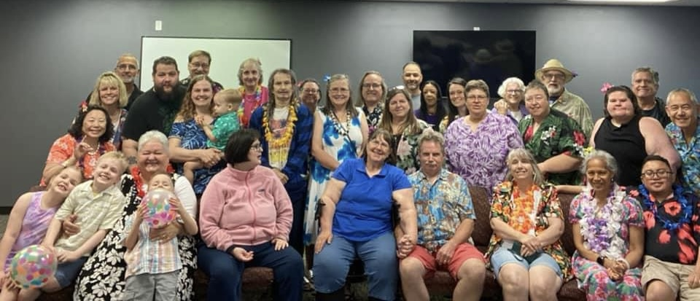
What will they say about you?
“By faith (your name) ...

