Slide 1
It is FINISHED... the CHOICE is Yours
Hebrews 10

Slide 2


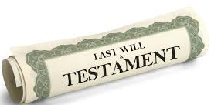

God’s Will (Hebrews 9: 16 – 23)
Heb 9: 16, “It is necessary to prove the death of the one who made it (the will).”
The death of Jesus opened the Will God established – giving all who believe/obey His Word access to all God provides
Impossible for sins to be forgiven without Jesus’ sacrifice
The OT sacrifices were preparation for the final sacrifice - Jesus!

Slide 3
Hebrews 10: 1 - 14
V1 – 4 Annually sacrifices had to be made but, “It is impossible for the blood of bulls and goats to take away sins.”
V5 – 11, “Jesus said, ‘Here I am, it is written about Me in the scrolls...I have come to do Your will, My God’.”
(v9) Jesus set aside the 1st Covenant and established the 2nd Covenant, and by that Will,
(v10) we have been made holy through His sacrifice ONCE and FOR ALL...

Slide 4
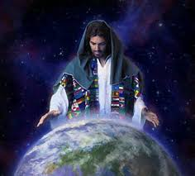
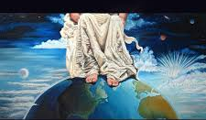
V12 – 14
V12 – 13, When He was done – the sacrifice was done – “He sat down at the right hand of God and since that time He waits for His enemies to become His footstool...”
V14, “He made perfect forever those who are being made holy”

Slide 5
V15 - 19
The Holy Spirit testifies:
This Covenant (the 2nd Covenant) I will make with them – all who believe
I will put my laws in their hearts and will write them on their minds
Their sins and lawless acts, I will remember them no more
When these sins have been forgiven, sacrifices are no longer necessary
Because of this, we have CONFIDENCE to enter the Most Holy of Holies by the blood of Jesus
Off point: Pres. Trump’s
recent state-ment

Slide 6
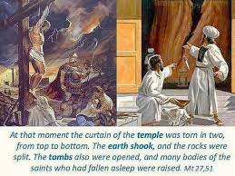
Because Jesus died on the cross:
V20-25, He opened the curtain for us (Matt 27:51+Mark & Luke)
Because we have such a great High Priest over the House of God
Let us draw near to God with full assurance of faith
Having our hearts sprinkled with His blood that cleanses our guilty conscience
z

Slide 7

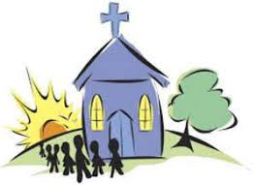
v 23 – 25
Let us hold UNSWERVINGLY to HOPE for He IS FAITHFUL
Let us consider/think how we may spur
one another toward love and good deeds
Not giving up on meeting together – encourage one another!
BDA

Slide 8
But... A stern warning (v26-31)
“If we deliberately keep sinning after we have received the knowledge of truth – no sacrifice is left ... Only left is a fearful expectation of judgement...”
How much more severely do you think those deserve to be punished who trample the Son of God...who treat His sacrifice as unholy...who have insulted the Spirit of grace...
It is a dreadful thing to fall into the Hands of the Living God.”

Slide 9
Remember Who You are (v32-35):
Historical Context: Nero (Roman Emperor) started the 1st wave of Roman persecution against Christians (54-68 ad)
Hebrews was written between 63 – 68 ad: during the time of Nero’s persecution
Remember: You endured great conflict full of suffering
Publicly insulted and persecuted
You stood with those who were persecuted
You suffered along with those in prison
You joyfully accepted the confiscation of your property
So, do not throw away your confidence, persevere...

Slide 10
V 36 – 39 Persevere
Persevere because you will receive His promise
He said, “In just a little while, He Who is coming will come and not delay”...
“My righteous ones will live by faith. And I take no pleasure in the ones who shirk back (return to Judaism)...”
“We are not of those who shirk back and are destroyed, but of (belong to) those who believe and are saved."

Slide 11
“Shirk back”
Muslim perspective: the greatest unforgivable sin – when a person associates with anything other than allah – no grace or mercy – unforgivable sin
Shirking back – returning to sin, grieves the heart of God, but He continues to call us back to Himself. It becomes unforgivable (blasphemy) when we deliberately push the Holy Spirit away and refuse to accept forgiveness and Jesus’ work on the cross.

Slide 12

V39 “We are not of those who shirk back and are destroyed, but of (belong to) those who believe and are saved."
Today, we started with the Will of God requiring a death
Jesus, the Word of God, said, “Here I am”
His death tore open the Holiest of Holies’ Temple curtain
The Holy Spirit testifies that because of Jesus’ sacrifice – we can be confident in our relationship with God the Father
Continue to gather together! Spur each other to Christlike action
You decide to stand strong!

