Slide 1
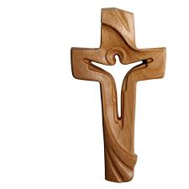
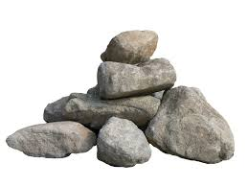
Old Testament Boulders Leading Us to the Book of Hebrews!
400 yrs of Silence
Prophets
Joshua, Kings + Captivities
Moses + Laws
Jacob + 12 Sons
Abraham
Isaac
Boulder Series #1
Genesis 3: 15 – God’s 1st Promise of Salvation

Slide 2
Genesis 3:15
“The Lord said to the serpent…I will put enmity between you and the woman, and between your offspring and hers; and he will crush your head, and you will strike his heel.”

Slide 3
Genesis 12: 2 – 3
“I will make you into a great nation, and I will bless you;
I will make your name great, and you will be a blessing,
I will bless those who bless you, and whoever curses you I will curse,
And all the peoples on earth will be blessed through you.”
Jacob and 12 Sons
Abraham
Isaac

Slide 4
Isaac
Genesis 26: 2 – 5
“The Lord appeared to Isaac and said, ‘…I will be with you and bless you. For to you and your descendants I will give these lands and will confirm the oath I swore to your father Abraham. I will make your descendants as numerous as the stars…through your offspring all nations of the earth will be blessed, because Abraham obeyed Me…’”

Slide 5
Jacob –
God confirms Abraham/Isaac’s Covenant with Jacob
Genesis 28: 13 – 15, “…the Lord stood there and He said, ‘I am the Lord, the God of Abraham and the God of Isaac. I will give you and your descendants the land on which you are lying. Your descendants will be like the dust of the earth, and you will spread out to the west…east…north… and south. All peoples on earth will be blessed through you and your offspring. I am with you and will watch over you…I will not leave you until I have done what I have promised you.”

Slide 6
Jacob & 12 Sons (Gen 29 & 30)
Leah’s Sons | Rachel’s Sons
Ruben | Joseph
Simeon | Benjamin
Levi | Bilhah – Rachel’s servant
Judah | Dan
Issachar & Zebulun | Naphtali
Zilpah – Leah’s servant
Gad
Asher

Slide 7

Jacob’s Final Blessings For Each Son:
Genesis 49
Reuben: no longer excel – your sins… | Simeon: anger fierce – scattered
Levi: same as Simeon - scattered | Judah: praised and scepter will not depart – the Lion
Zebulun: successful sailors | Issachar: submit to labor – routine
Dan: will bring justice for his land | Gad: will be a strong warrior
Asher: known for delicacies (rich food) | Naphtali: like a doe set free
Joseph: fruitful vine (Ephraim & Manasseh) | Benjamin: a ravenous wolf

Slide 8
Transitional Events:
Joseph is sold to the Ishmaelites … who sell him to Egypt … he ends up in jail…interprets Pharoah’s dream…is promoted to 2nd in command of all of Egypt…terrible famine hits everywhere…Jacob and 11 sons join Joseph in Egypt (Gen 37 – 50)
After Joseph dies, new Pharoah forgets who Joseph was and makes the Hebrews slaves in Egypt…this continues for 400 years (Exodus 1)

Slide 9
Moses from Levi’s family line
Exodus 3: God calls Moses – burning bush. “…I AM the God of Abraham, the God of Isaac, the God of Jacob, … I have indeed seen My people’s misery…I have promised to bring you to the land that flows with milk and honey…
10 Plagues, the Lord parts the Red Sea…then 40 years wandering in the desert…
10 Commandments written by God and given to Moses…
Moses’ death recorded in Deut 34
Moses
Jacob + 12 Sons
Abraham
Isaac

Slide 10
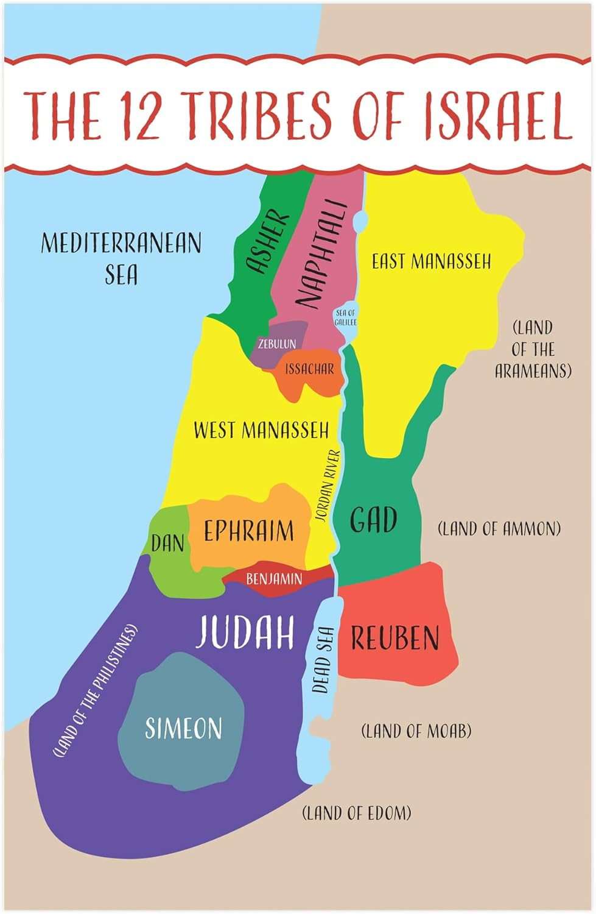
Joshua leads 12 Tribes to conquer the Promise Land. The Tribes become a Nation
Joshua, Kings & Captivities
Moses
Jacob + 12 Sons
Abraham
Isaac
Note: No land for Levi or Joseph (have his sons Ephraim & Manasseh)

Slide 11
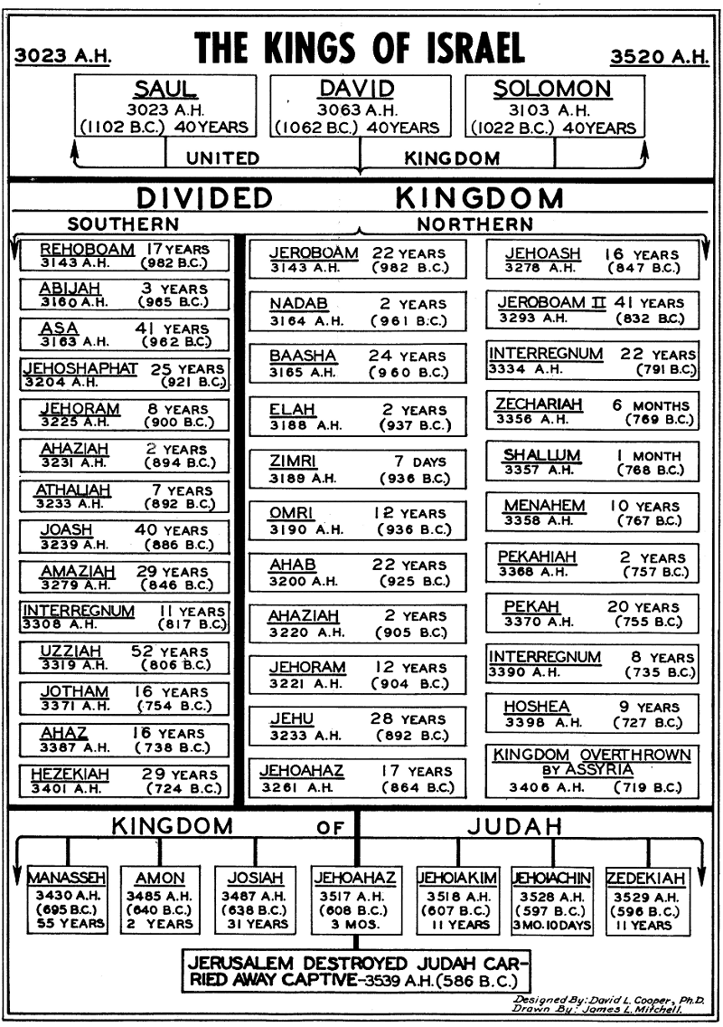
Davidic Covenant: II Sam 7: 5 – 16
“…the Lord Himself will establish your house…I will rise up your offspring to succeed you…from your own body, I will establish his kingdom…Your house and kingdom will endure forever before Me; your throne will be established forever.”
Kingdom Divided… 10 ‘States’ called the Northern Kingdom – Israel…the ‘State of Benjamin and State of Judah’ – Southern 2 ‘States’ was called Judah

Slide 12
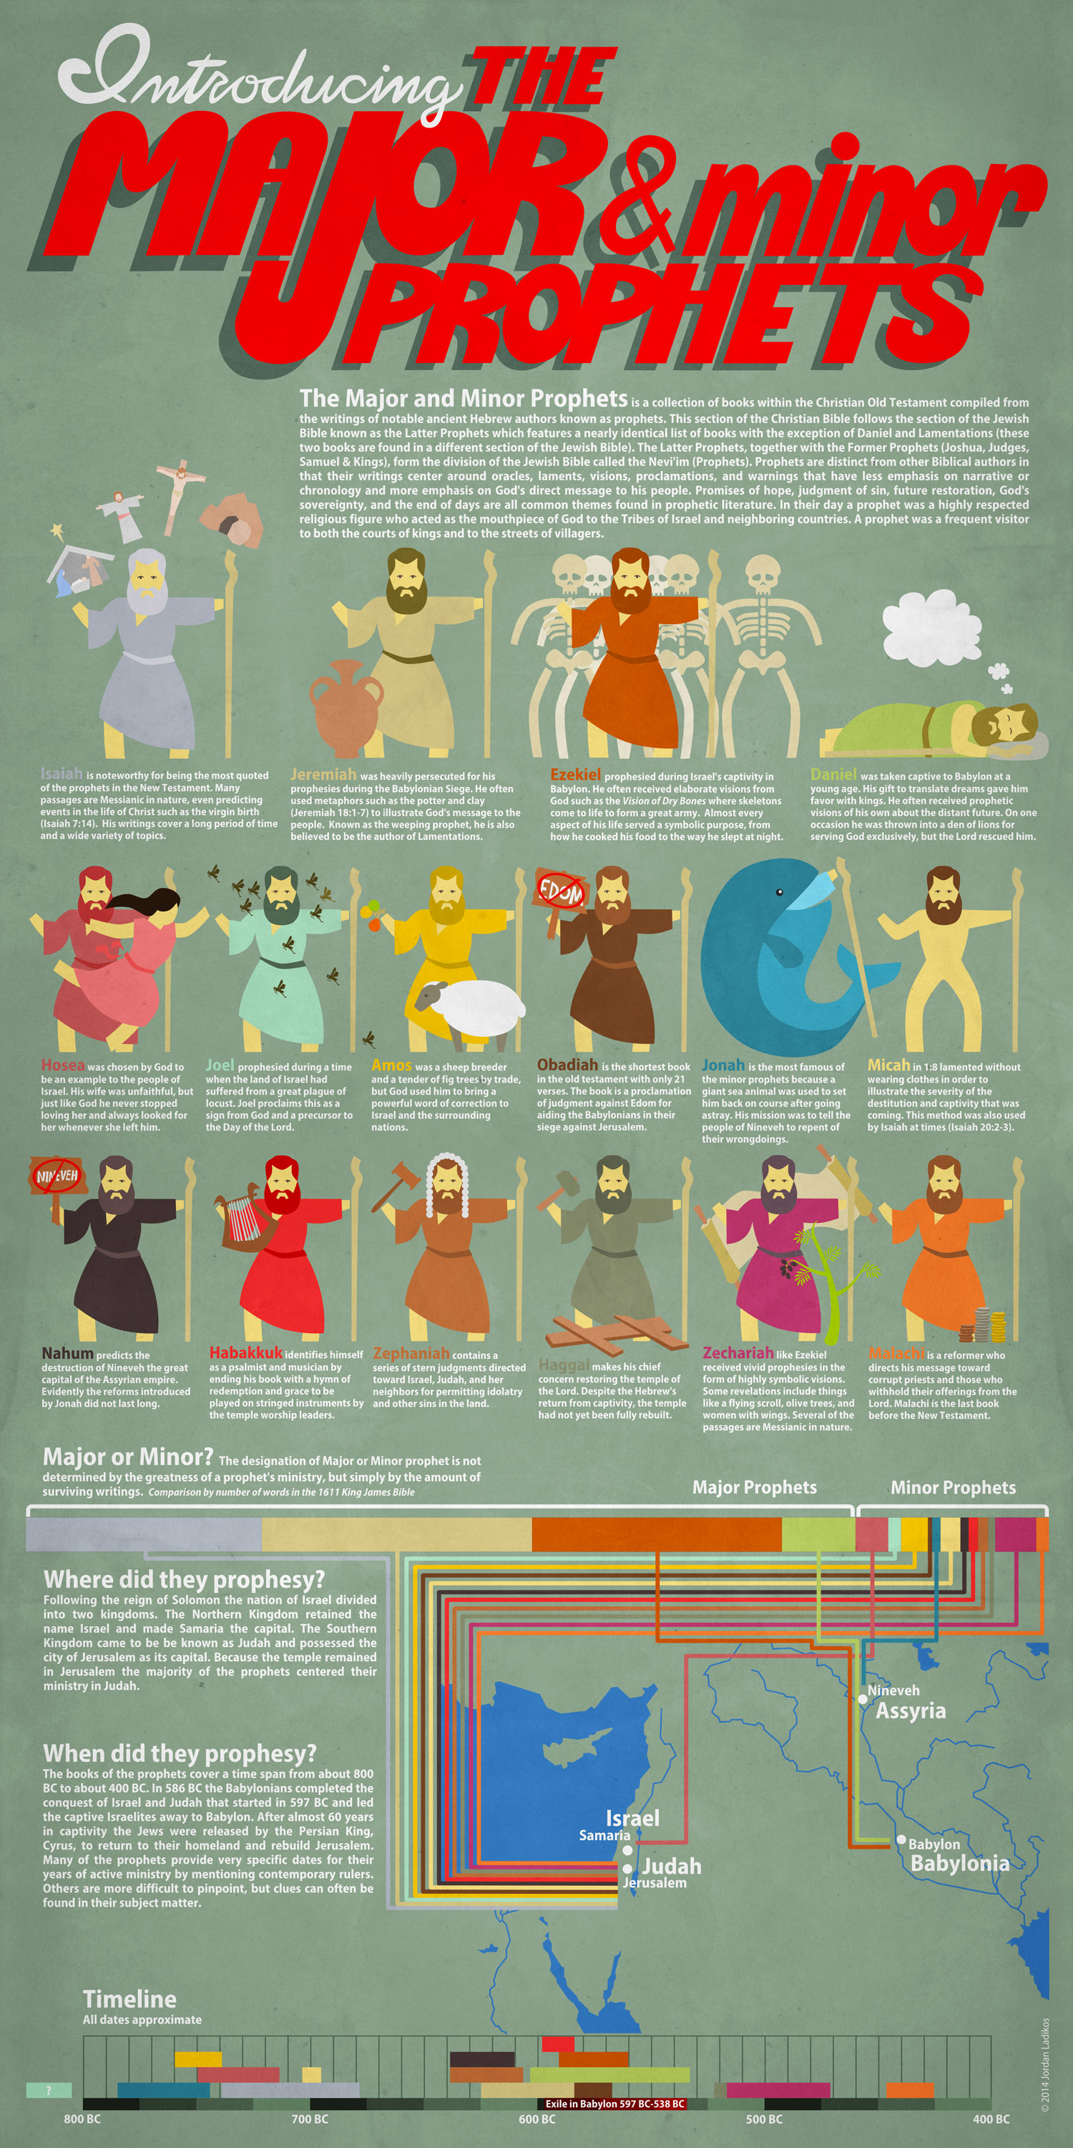
Prophets
Joshua, Kings + Captivities
Moses
Jacob + 12 Sons
Abraham
Isaac
Themes: God keeps His promises; God redeems; the Day of the Lord is coming

Slide 13
Covenants always initiated by God
Israel messed up again and again – same us! God same! Grace, Justice & Mercy continues to flow…
“Trust in the Lord with all your heart and lean not on your own understanding; in all your ways submit to Him, and He will make your paths straight.” Prov. 3: 5 & 6
Promises kept! Christ Jesus came – the Lion of Judah
Prophets
Joshua, Kings + Captivities
Moses
Jacob + 12 Sons
Abraham
Isaac

