Slide 1
Trouble at home!
Genesis 12: 10 – 13: 18

Slide 2
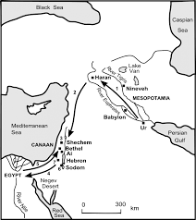
v12 Famine Hit…
V11-13 Abram takes his family to Egypt.

Slide 3
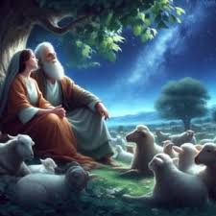
Egypt Experience…
Before they enter Egypt, Abram asks Sarai to say she is his sister – because she was so beautiful, he feared if they knew she was his wife, they would kill him to take her
Did they have to lie?

Slide 4
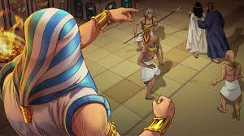
The Lord’s response (v14 – 20)…
It happened! Sarai was so beautiful, Egyptian officials took Sarai to be married to Pharoah!
He gave Abram cattle, sheep, etc.
God struck all of Pharoah’s palace with a disease because of Sarai
In the morning, Pharoah confronts Abram and sends him & everyone & everything with him out of Egypt!

Slide 5
I Peter 3: 3 - 8
Your beauty should not come from outward adornment
…but it should be that of your inner self – the unfading beauty of a quiet spirit, which is of great worth in God’s sight… they submitted themselves to their own husbands like Sarah, who obeyed Abraham and called him lord… you are her daughters.

Slide 6
Abraham returns to the Promise Land Genesis 13
Back to the Negev
Abram and Lot became very rich…they moved back to between Ai & Bethel and called on the Lord
Abram and Lot’s herdsmen began to fight because the land could not handle all their flocks and herds.
Abram told Lot, “Let’s not fight, we’re family”

Slide 7
Abram and Lot go separate ways…
Abram told Lot, “You go right, I will go left, you go left, I’ll go right… you choose”
Lot looked and saw the Jordan planes were well watered and green pastures with towns scattered nearby…that’s what he chose. (selfish…) Set-up his tent near Sodom…
Psalms 1 = you will be blessed if you do not walk with the wicked; or stand with sinners; or sit with those who are mockers…”

Slide 8
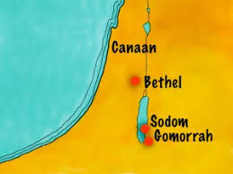
V13 Lot moved close to what God called wicked/sinful

Slide 9
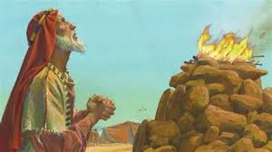
The Lord speaks to Abram again… v14 - 18
Look N, S, E, W…I am giving this to you and your descendants forever
Descendants as plentiful as dust!
Go and walk the length & breadth of all of what I am giving you – It is yours!
Abram built an altar of praise

Slide 10
Abram returned to Hebron
Trouble at home:
The famine, move to Egypt, the fear produced lie, return to Promise Land
Family split
“Have, have, have” not bring peace

Slide 11
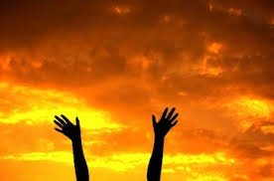
Peace and satisfaction – only from relationship with the Lord

