Slide 1
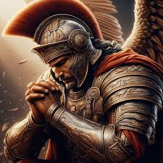
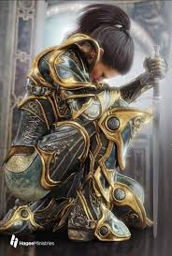
Stand firm!
Ephesians 6: 10 - 24

Slide 2
Put on the Whole Armor of God Ephesians 6: 10 - 18
¹⁰ A final word: Be strong in the Lord and in his mighty power.¹¹ Put on all of God’s armor so that you will be able to stand firm against all strategies of the devil. ¹² For we are not fighting against flesh-and-blood enemies, but against evil rulers and authorities of the unseen world, against mighty powers in this dark world, and against evil spirits in the heavenly places.
¹³ Therefore, put on every piece of God’s armor so you will be able to resist the enemy in the time of evil. Then after the battle you will still be standing firm.

Slide 3
¹⁴ Stand your ground, putting on the belt of truth and the body armor (breastplate) of God’s righteousness. ¹⁵ For shoes, put on the peace that comes from the Good News so that you will be fully prepared. ¹⁶ In addition to all of these, hold up the shield of faith to stop the fiery arrows of the devil. ¹⁷ Put on salvation as your helmet, and take the sword of the Spirit, which is the word of God.
¹⁸ Pray in the Spirit at all times and on every occasion. Stay alert and be persistent in your prayers for all believers everywhere.

Slide 4
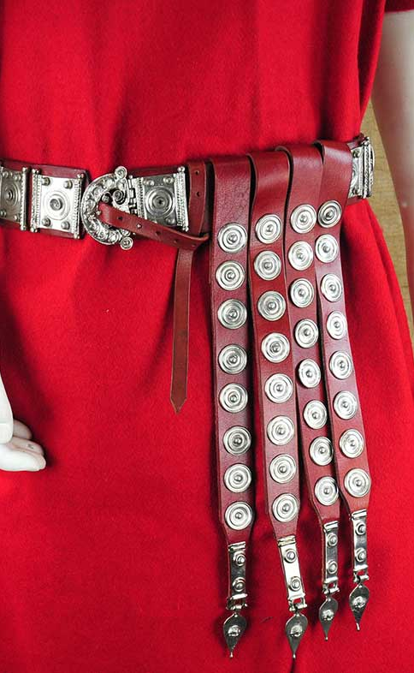
Belt of truth:
Tied in several places on the waist – no matter how the soldier moves – the belt stays on and stabilizes the soldier.
Has places for pouches for food, for weapons and for rope.
Keeping your life tied in truth – a life of integrity honors the Lord!

Slide 5
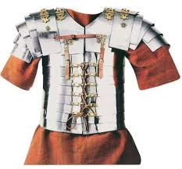
Breastplate of Righteousness
Protects the heart
Righteousness = doing what is right
“The belt of truth comes before righteousness because there can’t be righteousness without truth. Truth is the standard and righteousness reveals how to work that standard out.” (Evans 2011, 68)

Slide 6
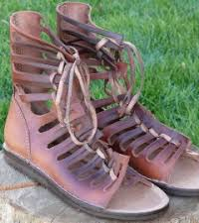
Shoes – Readiness – Peace that comes from the gospel
A peace that comes from a knowledge of the gospel that we are saved in Christ and have nothing to fear, from our knowledge that we have our identity in Christ, and able to walk blameless before God because we pursue righteousness

Slide 7
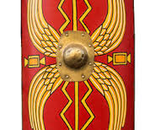
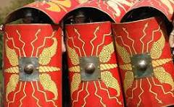
Shield of faith
Rectangular from chin to knee for the soldier to kneel or stand behind
Protects from fiery arrows from the enemy
Soldiers would group together holding their shields together to create a wall of protection
Faith in the Lord strengthens us, protects from deception and doubts, and gives us the courage to move forward

Slide 8
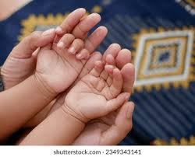
BDA Mom’s Monday prayer and fasting group…
An inspiring FYI:
This is an open invitation for our BDA moms to unite together on Mondays to fasting and pray for your children and grandchildren.
Email Pastor JoAnn:
joanns@bcachurch.com

Slide 9
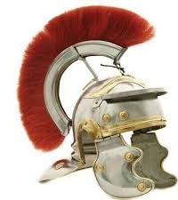
Helmet of Salvation
Covers the head, face, and neck
Protects from fatal hits to the head – instant death hit
Helmet of Salvation – includes all that Christ has for us, we are His! Our past, present, and future is covered!
Protects our mind from deception and evil thoughts

Slide 10
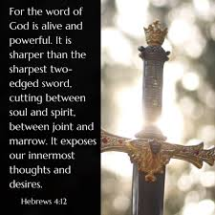
Sword of the Spirit
Not a dagger (knife) – not to jab or stab with
A brutal weapon designed to kill the enemy and his attacks – not to wound/hurt – but to destroy!
Our offensive weapon
It is the Word of God that defeats the enemy

Slide 11
^{V11 “}Put on all of God’s armor so that you will be able to stand firm against all strategies of the devil.”
This is a command – not a suggestion!
Put on the armor of God!
Worship Him with songs and verses of praise!

Slide 12
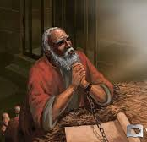
Paul’s final greetings to believers in Ephesus:
V19 – 24
Pray for me – preach fearlessly the mysteries of Christ
I am an Ambassador in chains
Sending Tychicus to assure you, I, Paul am doing well – be encouraged
Love each other with faith
Grace to you who love Him with an undying love!

Slide 13
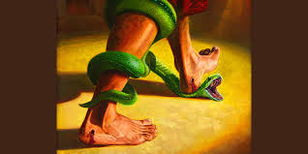
Remember!
“…greater is He Who is in you than he who is in the world.” I John 4: 4
Put on ALL the Armor of God!

