Slide 1
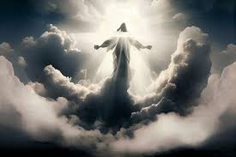
2 TIMOTHY 4:8B ALL WHO LONG FOR HIS APPEARING
PROPHETIC SCRIPTURES 29% of BIBLE

Slide 2
2 PETER 3:14

Slide 3
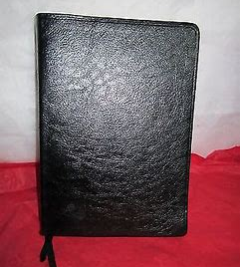
Pastor Rod's Personal Testimony:
Born again in November 1975
Attended New Covenant Fellowship Church
Read the entire Bible
Focused on the gospels
Revelation extremely difficult

Slide 4
FIRST MOVIE IMPACT made 1972

Slide 5
BOOK "LATE GREAT PLANET EARTH"

Slide 6
THE GATHERING 2024​ BASED ON 3 SCRIPTURES
JOHN 14
1 CORINTHIANS 15
1 THESSALONIANS 4
Read/study/memorize

Slide 7
GATHERING (RAPTURE)

Slide 8
1. CHAOS on Earth

Slide 9
PEOPLE GO MISSING
Including mentally disabled
NO BORN AGAIN CHRISTIANS LEFT
HIS CHURCH that LOVE Him
FINAL generation of Christians
Can happen at any time with NO warning
Those that are prepared

Slide 10
2. GREAT DAY

Slide 11
ZEPHaniah 1:14

Slide 12
2 timothy 4:8

Slide 13
THIS IS OUR HOPE who put trust in jesus christ
T\

Slide 14
Hope 1 peter 1:3

Slide 15
1 PETER 1:13 SET YOUR HOPE

Slide 16
HOPE in HEBREWS 6:18

Slide 17
HOPE - HEBREWS 6:19

Slide 18
HOPe - TITUS 2: 13

Slide 19
HOPe - ROMANS 5:5

Slide 20
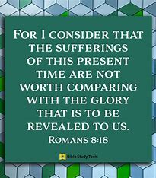
HOPE-ROMANS 8:18

Slide 21
HOPE - PHILIPpIANS 1:6

Slide 22
HOPE: GALATIANS 5:5

Slide 23
HOPE: 1 THESSALONIANS 4:13-18

Slide 24
THAT DAY (GATHERING)

