Slide 1
Justified by Faith
Galatians

Slide 2
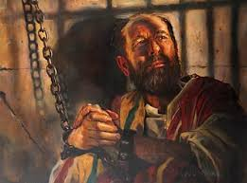
Meet Paul the Apostle: the author of Galatians

Slide 4
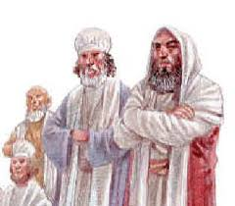
The Story
Paul completed his 1st Missionary (48-49 ad) and heard a group of Jews – who became Christian – mandated the Galatian Christians (non-Jews/Gentiles) to follow all the Jewish laws before they could truly be saved.
This group of Jewish-Christian were called Judaizers. Were they really Christians?
Paul’s response … “No! This legalism negates God’s grace.”

Slide 5
Chapters 1 & 2
I have been called by Jesus to preach the gospel to the Gentiles
Jesus revealed Himself to me
I persecuted the Church to strengthen Judaism and the Law
3 yrs in Arabian desert then to Damascus
Stayed with Peter 14 days and met with James
Went to Syria and Cilicia – no one knew me
After 14 yrs, went to Jerusalem with Barnabas
First Missionary journey (2-4 yrs) – returned to Jerusalem for Acts 15 Council
Had a conflict with Peter – hypocrisy
“You are justified by faith not works!
Paul Defends himself…

Slide 6
Paul declares (2:20-21):
“I have been crucified with Christ and I no longer live, but Christ lives in me. The life I now live in the body, I live by faith in the Son of God, Who loved me and gave His life for me… for if righteousness could be gained through the law, Christ died for nothing!”

Slide 7
1: 6-10 “I am astonished how quickly you strayed from the truth!”
3:3 “Are you trying to finish (your salvation) by human efforts?”
V6-16 Look at Abraham! It was his faith that was credited as righteousness
God gave Abraham a promise that his seed would bless all the nations
Abraham’s seed – not seeds: Seeds = the Jewish Nation; Seed = one individual = the Messiah Jesus Christ
The Law was given to us as guardians – setting boundaries to guide our relationship with God until the Seed/Messiah came to pay our debt of sin once and for all

Slide 8
Chapter 4
V9 As God’s children, heirs to His Kingdom, why are you returning to slavery?
V11 Have I wasted my efforts with you?
V15 What happened to your joy?
V16 Am I now your enemy because I speak the truth?
V21-31 Look at Hagar and Sarah…Hagar represents the Law and human efforts – Sarah represents God’s promises!

Slide 9
Chapter 5 & 6 Practice faith and your freedom
Legalism alienates from grace and is slavery
5:13 You are called to be free – not to indulge in satisfying sinful nature…but free to serve others in love
5:15 If you keep on biting and devouring each other, watch out or you will be destroyed by each other! – STOP back biting!
Acts of Sinful nature: sexual immorality, impurity, debauchery, idolatry, witchcraft, hatred, discord, jealousy, fits of rage, selfish ambitions, dissensions, factions, envy, drunkenness, orgies, and the like…those who live like this will not inherit the Kingdom of God.”

Slide 10
The acts of the Spirit = the Fruit of the Spirit (5:22-23)
The fruit of the Spirit is love, joy, peace, patience, kindness, goodness, faithfulness, gentleness, and self-control…there are no laws against these!
***Now put your name in front of each: _________has love; _____has joy; ____has peace; ______has patience….etc… how did you do??
V24 If you belong to Christ, your sinful nature has been crucified in Him!

Slide 11
Chapter 6 Practice your Faith and Fruit
V 1 If someone is caught in sin, gently restore them. Watch yourself that you do not fall into same sin
V2 Carry one another’s burdens and fulfill the law of Christ
V4-6 Test your own actions! Do not compare yourself to others! Carry your own load!
V7 People reap what they sow: sow sin = reap destruction; sow to please the Spirit = reap eternal life
V9-10 Do not become tired of doing good! Let us continue to do good especially to those in the household of faith

Slide 12
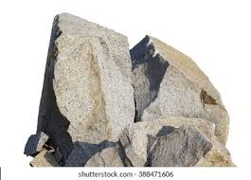
The BiG Rocks:
Paul, an apostle, was called by Jesus to preach to the non-Jews/Gentiles
We are justified by faith in Jesus – not by works
As true followers of Jesus, our lives should produce the fruit of the Spirit
This fruit in us will develop a love for one another and desire to serve Him and each other.

