Slide 1
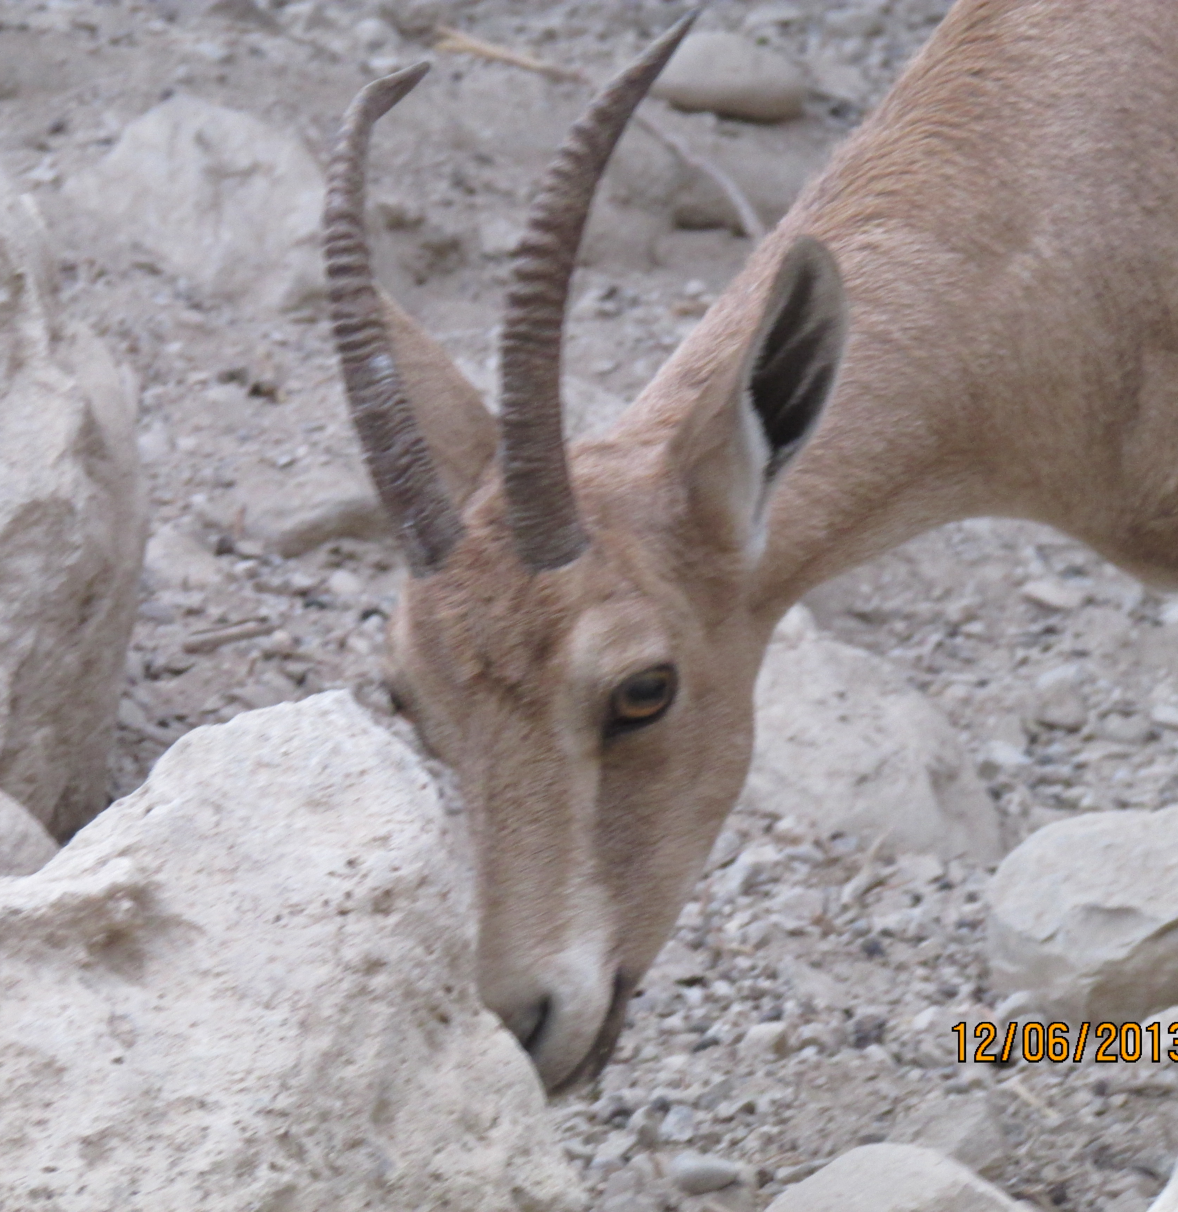
Habakkuk “Embraced by God”

Slide 3
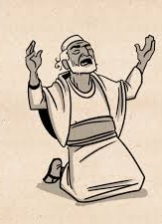
Habakkuk: Embraced by God
Prophet during the fall of Assyria (Nineveh) – 612bc. Remember Jonah and Nahum
Between the years of 612 bc; Josiah died in 609 bc; and Nebuchadnezzar became the Babylonian King in 605 bc.
Identified as a Levite because of his songs and use of poems throughout his writings (1:2-4; 1: 12-17; and 3: 1-19).

Slide 4
Q & A Between Habakkuk and God:
Chapter 1:
V2 Q: “How long, Lord, must I call for help…but You don’t save?” “Why do you tolerate wrongdoings?”
V6 A: “Look … watch… and be utterly amazed! I am raising up the Babylonians…”
V12 Q: “Lord, are You not from everlasting? My God, my Holy One, You will never die. You, Lord, have appointed them (Babylon) to execute judgement; You, my Rock, have ordained them (Babylonians) to punish…”

Slide 5
Chapter 2
2:1 “I (Habakkuk) will stand at my watch … I will look to see what He will say to me…”
V3: A: “The revelation awaits an appointed time…though it lingers, wait for it; it will certainly come without delay.”
V 4: “The righteous will live by their faithfulness.”
5 Woes – woes are a declaration of judgement to come

Slide 6
The 5 Woes (vv 6 – 19):
#1. Woe to him who makes himself wealthy by extortion! – gives loans but charges high interest rates
#2. Woe to him who builds his life by ruining many people! – Abuse of power (Deut. 16:19)
#3. Woe to him who builds a city with bloodshed and injustice! – Corrupt political system (Micah 3:10)
#4. Woe him who exploits his neighbor to disclose their secrets to gain his own glory
#5. Woe to him who worship anything other than the Lord God!

Slide 7
V20: “The Lord is in His holy temple; let all the earth be silent before Him” – a command to stop and reflect!
Chapter 3 Song of Praise and Worship
V2 “Lord, I have heard of Your fame (Red Sea, crossing of Jordan, and miracles of past); I stand in awe of Your deeds, Lord. Renew them in our day (do it again, Lord), in our time make them known; in wrath remember mercy…”
V13 “You came out to deliver Your people, to save Your anointed one.

Slide 8
V16 “I heard and my heart pounded, my lips quivered at the sound … my legs tremble. Yet I will wait patiently for the day of calamity (Babylon's conquest of Judah).
V17 “Though the fig tree does not bud and there are no grapes on the vines; though the olive crop fails and the fields produce no food; though there are no sheep in the pen and no cattle in the stalls
V18 yet, I will rejoice in the Lord, I will be joyful in God my Savior”.

Slide 9
V19 “The Sovereign Lord is my strength; He makes my feet like the feet of a deer, He enables me to tread on the heights”

Slide 11
How often have you asked the Lord, “how long will it be before You answer me?” How long will You let sin rule?
His answer remains the same: “Look … watch… and be utterly amazed!...The revelation awaits an appointed time…though it lingers, wait for it; it will certainly come without delay.”
“The righteous will live by their faithfulness.”

Slide 12
His Promise:
V19 “The Sovereign Lord is my strength; He makes my feet like the feet of a deer, He enables me to tread on the heights.”
Do it again, Lord!
Wait for it!

