Slide 1
BIB 114
Unit 2
Sessions #5 & 6

Slide 2

Early Narratives & Prep for Ministry
Unit #5

Slide 3
Luke 1 = Elizabeth, Zechariah, & John
Luke is the only gospel that tells the story of John the Baptizer’s conception and birth.
Duties of the priests (I Chronicles 23 & 24)
  Be in charge of the Temple work
  Be officials and judges
  Musicians of worship & praise
  Offer sacrifices and minister before the Lord
  Pronounce blessings
  Be responsible for the Temple courtyard, side rooms, purify all sacred things, etc.
  Cast lots for service rotation

Slide 4
Let’s look at Zechariah and Elizabeth’s story/events
John’s purpose: 1) to be a joy to his parents and others; 2) turn many Israelites back to the Lord; 3) to prepare the people for the coming Messiah
John was a Judean, Jesus was a Galilean…Galileans were more accepting of other cultures and friendlier. Judeans were more rigid, closed, serious, and concerned with religious purity. John: accused of being too sober; Jesus was accused of being a drunkard and glutton…

Slide 5
Both Matt and Luke record the ‘annunciation of the birth of Jesus…Matt focuses on Joseph’s experience while Luke focuses on Mary’s experience…remember who each gospel writer was writing to…
What would the Christmas story be like without both records?
  Without Luke, the story of the angels and shepherds would be missing
  Without Matt, there would be no record of the Wisemen’s visit and Joseph taking Mary and Jesus to Egypt for safety – running from King Herod

Slide 6
Luke’s Christmas Details
  Jesus’ parents lived in Nazareth before His birth (1:26; 2:4).
  Mary was Elizabeth’s relative (1:36).
  Mary stayed with Elizabeth for three months before the birth of John the Baptist (1:39–56).
  Caesar Augustus decreed that a census should be taken of the entire Roman world (2:1).
  Joseph and Mary went to Bethlehem, where Christ was born, to register because of Caesar’s decree (2:1–7).
  An angel announced Christ’s birth (accompanied by a host of praising angels) to nearby shepherds, who then went to visit Him (2:8–20).
  Christ underwent rites of circumcision and purification in accordance with the Law (2:21–39).
  Christ experienced normal childhood growth and development as He matured (2:40–52).

Slide 7
Jesus’ Lineage…
Matthew’s:
Luke’s:
Starts with Abraham and ends with Jesus
Names from Abraham to David – same in both
Names from David to Jesus very different from Luke’s
Matt identified Jesus’ royal lineage – the Messiah
Starts with Jesus and ends with Adam
Names from Abraham to David – same in both
Names from David to Jesus very different from Matt
Luke identified Jesus’ physical lineage thru Mary

Slide 8
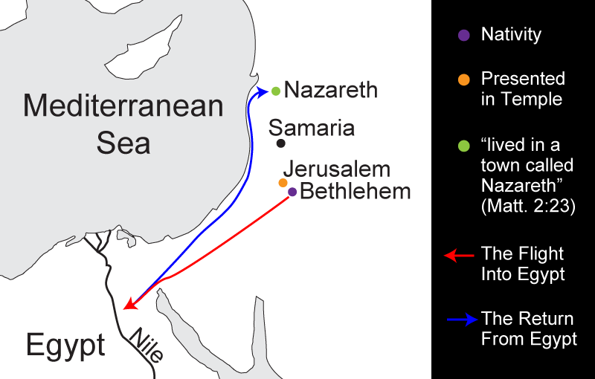
Map of Jesus’ Early Years

Slide 9




Session 5
Worksheet #8

Slide 10
Matt 2:13-16 = Herod’s jealousy and rage against the Messiah’s birth and Magi’s visit fulfilled the prophesy of Hosea 11:1
After the return to Nazareth, we read nothing more about the baby Jesus until he is 12/13 in Luke 2:49 – Jesus at the Temple. By this time, Jesus already understood Who He was – look at His response to Mary and Joseph after they returned to the Temple to find Jesus. “Didn’t you know I had to be in my Father’s house?”
Jesus returned to Nazareth – obedient to His earthly parents – fulfilling the Law with respect and love.

Slide 11
A look at “John’s baptism” – he is known as the ‘last OT prophet’
Thoughts about water baptism and us as believers…Romans 6: 3 & 4

Slide 12
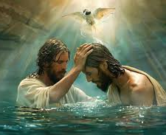
Jesus’ Baptism – Matt 3, Mark 1, and Luke 3
Jesus did not have to repent … pure – no sins
Matt 3:15 Jesus said, “Let it be so now; it is proper for us to do this to fulfill all righteousness.”

Slide 13

Satan tempts Jesus:
  Provision
  Protection and
  Power
Heb 2: 18
“Because He Himself suffered when He was tempted, He is able to help those who are being tempted.”
Matt 4: 1 - 11

Slide 14
Unit 2
Session #6

Slide 15
The Early Judean and Galilean Ministry
Early Time Markers:
Birth of Jesus – Herod the Great’s reign and death = 4bc; Matt 2:1 & Luke 2: 4-7
Beginning of John’s ministry during the 15th year of Tiberius Caesar’s reign: 27 – 29ad (Luke 3: 1 – 3)
Jesus is approximately 30 yr old (Luke 3: 23)
Archelaus begins his reign after Herod’s death (Matt 2: 19 – 22)

Slide 16
Unit #2
Session #6
Worksheet #9

Slide 17
Consider:
John the Baptizer was imprisoned during Herod Antipas’ rule – at the end of Jesus’ first year of ministry
Read: Matt 4: 12 and Mark 1: 14 These verses connect John’s imprisonment with Jesus’ decision to return to Galilee. Jesus was avoiding unnecessary exposure to Him and His ministry.

Slide 19
The Early Period – Galilean Ministry
Mark 1: 14 – 3: 19
Matt 4: 12 – 12: 14
Luke 4: 14 – 17; and Luke 9: 1 – 6

Slide 20
Jesus’ 2nd Year of Ministry = Middle and Late Galilean Period
The middle period shows increasing events of conflict, controversy and decline in His popularity…Why?
Let’s look at:
  Luke 7: 18 – 35 John the Baptizer’s questions
  Matt 11: 20 – 24 Jesus condemnation of Galilean cities
  Mark 6: 1 – 6 Unbelief and rejection in hometown Nazareth
  John 6: 22 – 71 Many followers reject His ultimate purpose
  Matt 14: 1 – 13 John the Baptizer is beheaded

Slide 21
Overall, Jesus’ Galilean ministry lasted approx. 20 months
Jesus spent an increasing amount of time with His disciples

